Slide 1
Introduction to Mental health
Joseph Korge MSc
joseph.korge@oxfordhealth.nhs.uk

Slide 2
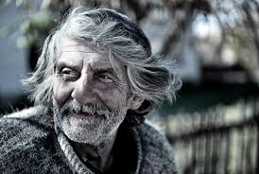
What is Mental Health?
Psychological well being
Ability to enjoy life
Mental performance
Productivity
Societal norms
Consistency – mood, behaviour, functioning.
Level of function
Ability to cope
Behavioural adjustment
Circumstantial

Slide 3
The Numbers
Mental illness is one of the main causes of disease burden worldwide (1).
1 in 6 in the last week, 1 in 4 in the last year (2).
UK cost = £100bn per year (3).
30% people with chronic physical illness (3).
6,233 suicides recorded in the UK in 2013 (3).
Prevalence =relevance.

Slide 4
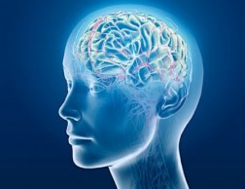
MH Diagnoses
Depression
Anxiety
Bipolar disorder
Schizophrenia
Bipolar-affective disorder
Schizo-affective disorder
Personality disorders
Eating disorders
Addiction
PTSD
OCD

Slide 5
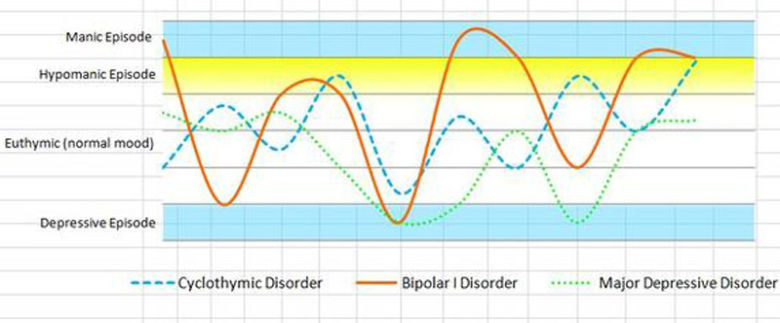
Bipolar Disorder
Episodes of depression and elation
Mood instability – 1% of population(3).
Type I, Type II, Rapid Cycling, Cyclothymia.

Slide 6
Bipolar Disorder
Constant sadness
Loss of appetite
Anhedonia
Nihilism
Low self-esteem
Isolation
Poor sleep and self care
Avoiding eye contact
Suicidality
Very happy
Flight of ideas
Full of energy
Over exercising
Reckless spending
Disinhibition
Grandiosity
Frustrated with others who aren’t as happy
Notes:
Achilles Tendinopathy Case Example

Slide 7
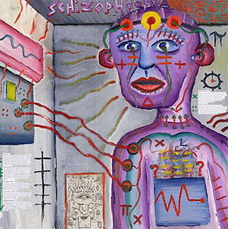
Schizophrenia
Abnormal social behaviour
Inability to understand what is real
Hallucinations
False beliefs
0.3-0.7% prevalence
Risk factors include genetics, being male, cannabis use, older parents, being raised in a city.
Culture must be considered
Paranoia
Split Personality
https://www.youtube.com/watch?v=SN1GCoVzxGg

Slide 8
Culture and Schizophrenia
Incidence of SCZ in black African and Caribbean population much higher than white population in UK (9)
Nine times more likely (10)
Differences in culture?
Trend has continued with second and third generation migrants.
Many African religions include spiritual beliefs
Shamanism – ability to connect with supernatural realm, an aspect of many religions.
Ireland – delusions of sainthood
Industrialised countries – delusions of surveillance
Cultural/societal norms – who can diagnose?

Slide 9
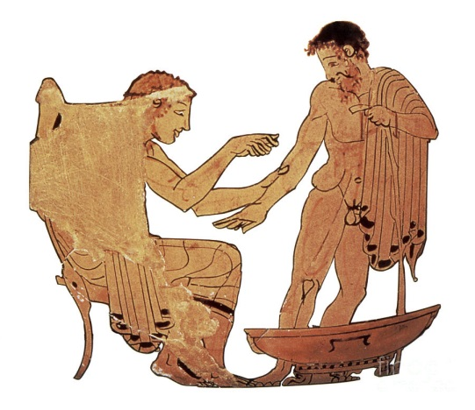
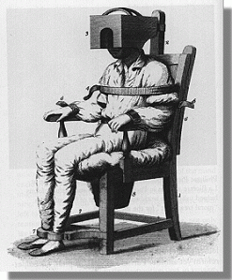
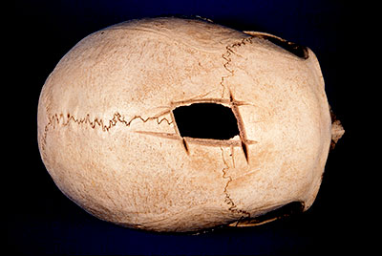
History of MH Rx
5000BC
Skull trephination
Lobotomies
Exorcisms
Isolation
1st-20th Century
Asylums, mad houses, workhouses.
Religion
Abandonment
Abuse and restraint
Confinement
Untrained staff
Ancient Greece
Biomedical model
Blood letting
Purging
Imposing balanced diets
Environmental change
Occupational change

Slide 10
Modern MH Rx
Medication
Antidepressants
Antipsychotics
Mood Stabilisers
Anxiolytics
Talking Therapy
CBT
Mindfulness
Psychotherapy
Psychology
Social Care
Community support
Financial support
Housing
Community Teams
Dedicated Care Co-ordinator
Multi-disciplinary
Assistance with occupation
Social inclusion schemes
Point of contact for all care needs
Medication issues
Acute Hospital Care
Controlled environment
Medication trials
MDT
Identification of needs
Assessment of risks
Episodes of increased illness severity
Electro-convulsive Therapy
Electrical current into the brain - seizure
Treatment resistant depression
Psychotic depression
Catatonia - SCZ
Informed consent
Safe environment

Slide 11
Medication Side effects
Nausea – Indigestion – Constipation – Diarrhoea - Ache
Agitation – Insomnia – Anxiety – Sexual Dysfunction
Stiffness – Restlessness – Sleepiness – Tardive Dyskinesia
Weight Gain – Slowness – Increased Thirst – Urinary Frequency – Muscle Weakness – Shaking – Drooling – Dry Skin – Headaches – Sweating – Goitre – Feinting Bradycardia – Bradykinesia – Increased Appetite Confusion – Memory Loss – Tinnitus – Visual Disturbance
Ataxia – Skin Rashes – Itchiness – Hair Loss – Fluid Retention – Reduced WBC – Chills – Fever – Anhedonia

Slide 12
MH and PH
4.1 times the overall risk of premature death (4)
Dying up to 20 years too early (5)
Twice the risk of diabetes (6)
3 times the risk of hypertension (7)
10 fold increase in deaths from respiratory disease (7)
Physical disease is under-diagnosed and under treated in people with schizophrenia (8)

Slide 13
PH and MH
30% stroke patients suffer depression (11)
Long term physical morbidity = 3 times more likely to have MH problems than population (12)
Major depression 4 times greater in people with chronic LBP (13)
Gulliver et al. 2015 – half of elite athletes suffering symptoms of mental ill health (14)
Fipro study 2015 – 38% professional footballers suffering with depression (13% in gen pop) (15)

Slide 14
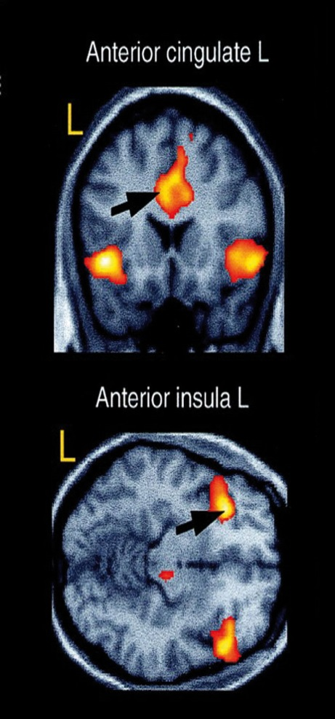
Anterior Insula and Anterior Cingulate Cortex
Emotions, experience, perceptions.
fMRI studies – same regions activated with pain
DeWall et al 2010 – paracetamol reduces psychological pain/hurt (16)
Demonstrating substantial overlap between physical and psychological pain.

Slide 15
Brief Summary
Humans are incredibly complex creatures
Mental illness is common
Even more common with physical morbidity
Linked to poor physical health and early death
You will have mentally unwell patients in every specialty of physiotherapy
Therefore:
Every physiotherapist should understand:
Symptoms of mental illness
Treatments for mental illness – side effects
Impact of mental illness on physiotherapy Rx

Slide 16
References
Vos, T., et al. (2013) Global, regional, and national incidence, prevalence, and years lived with disability for 301 acute and chronic diseases and injuries in 188 countries, 1990–2013: a systematic analysis for the Global Burden of Disease Study. The Lancet. 386 (9995). pp. 743-800.
McManus S, Bebbington P, Jenkins R, Brugha T. (eds.) (2016) Mental health and wellbeing in England: Adult Psychiatric Morbidity Survey 2014. Leeds: NHS Digital. Available .
Metalhealth.org.uk (2015)
Newman SC, Bland RC. (1991). Mortality in a cohort of patients with schizophrenia: a record linkage study. Can J Psychiatry 36, pp 239–45.
Brown S, Kim M, Mitchell C and Inskip H., (2010). Twenty-five year mortality of a community cohort with schizophrenia. British Journal of Psychiatry 196 pp 116–21.
Royal College of Psychiatrists, 2013 ‘Whole person care: from rhetoric to reality. Achieving parity between mental and physical health’, Occasional paper OP88.
Mental health and smoking: a position statement (2008), Faculty of Public Health.
Smith DJ, Langan J, McLean G, et al Schizophrenia is associated with excess multiple physical-health comorbidities but low levels of recorded cardiovascular disease in primary care: cross-sectional study. BMJ Open 2013;3:e002808. doi: 10.1136/bmjopen-2013-002808
Pinto R, Ashworth M, Jones R. Schizophrenia in black Caribbeans living in the UK: an exploration of underlying causes of the high incidence rate. The British Journal of General Practice. 2008;58(551):429-434. doi:10.3399/bjgp08X299254.
Fearon P, Kirkbride J, Morgan C, et al. Incidence of schizophrenia and other psychoses in ethnic minority groups: results from the MRC ÆSOP Study. Psychol Med. 2006;36(11):1541–1550
Paolucci S. Epidemiology and treatment of post-stroke depression. Neuropsychiatric Disease and Treatment. 2008;4(1):145-154.
Naylor, C. (et al) The King’s Fund: Long Term Conditions and Mental Health (2012). Available online.
Sullivan, M. J., (et al) The treatment of depression in chronic low back pain. Pain (1992). Available online.
Gulliver, A., Griffiths, K. M., Mackinnon, A., Batterham, P. J., and Stanimirovic, R. (2015). The mental health of Australian elite athletes. J. Sci. Med. Sport 18, 255–261.
Guardian UK 2015, report on Fipro study. Available at: https://www.theguardian.com/football/2015/oct/06/depression-professional-football-fifpro-survey
DeWall, N. C., et al. Acetaminophen Reduces Social Pain. Psychological Science (2010). Available Online.

