Slide 1
The future is not like the Isle of Man, a destination awaiting our arrival, it is like the Forth Bridge or the Birmingham canal system , something we have to imagine, design, plan and build.

Slide 3
The aim is to increase healthy life expectancy
ABILITY
AGE
THE LINE –
ABILITY REQUIRED TO GET TOTHE TOILET IN TIME
Death

Slide 4
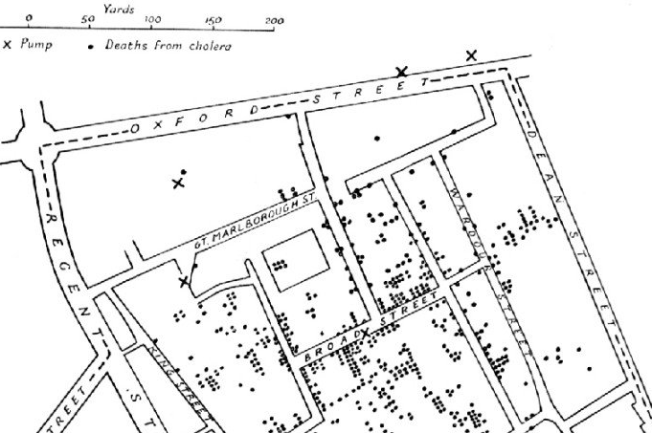
We have had 2 healthcare revolutions, with amazing impact
The First was the public health revolution
The Second has been the technological revolution supported by 50 years of increased investment & 20 years of evidence based medicine, quality and safety improvement eg
Antibiotics
MRI & CT
Coronary artery bypass graft surgery
Hip & knee replacement
Chemotherapy
Radiotherapy
Randomised controlled trials
Systematic reviews

Slide 5
after 50 years of progress all societies still face three massive problems.
The first is unwarranted variation in healthcare ie ”Variation in utilization of health care services that cannot be explained by variation in patient need or patient preferences.”
Jack Wennberg
Variation reveals the other two problems

Slide 6
The firwst is Underuse of high value interventions which results in
1. Preventable disability and death eg if we managed atrial fibrillation optimally there would be 5,000 fewer strokes and10% reduction in vascular dementia, and
2. inequity
Notes:
This was in the NHS Atlas of Variation

Slide 7
The first is overuse which
1. always wastes resources and
2. can cause harm
BENEFIT
HARM
Effect
Size
Benefit – harm
Resources
ECONOMIC
VALUE
Higher Lower POINT
OF
OPTIMALITY
Notes:
The service provider needs to know that the options for a particular intervention are not static . As we treat more people we treat less severely affect people who have a different benefit to harm ratio
One of the benefits of evidence-based medicine was that it emphasised the need to ensure that the only interventions being offered were those for which there was strong evidence that they did more good than harm. However, the balance of good to harm changes as the amount of resources invested in a health service increases. This was first demonstrated by Avedis Donabedian in 1980. Donabedian called the point beyond which further investment of resources would not increase value for the population the point of optimality.
This is illustrated in the figure on the ppt - emaphasise that THISIS THE MOST IMPORTANT PICUTE IN HEALTHCARE
Ask the participants to identify examples working in pairs for 2 minutescommonly the y produce
Antibiotics
Chemptherapy ion the last week of life
Elderly people with multiple disorders dying in intensive care
Rarely do the comment on
The last 10% in the increase in imaging ( going up at 8-10% per year)
The last 10% in the increase in lab testing ( going up at 8-10% per year)
Emphasise THIS HAS NOTHING TO DO WITH MONEY
[raise the choosing wisely campaign http://www.choosingwisely.org amd the BMJ’s too Much medicine http://www.bmj.com/too-much-medicine
Table. The 6 General Competencies of the Accreditation Council for Graduate Medical Education/American Board of Medical Specialties, and the Proposed Seventh Competency
Medical Knowledge
Patient care
Professionalism
Interpersonal and communication skills
Practice-based learning and improvement
Systems-based practice
Proposed new competency: cost-conscious care and stewardship of resources
Source: Weinberger, S.E., (2011) Providing high value, cost-conscious care: a critical seventh general competency for physicians. Annals of Internal Medicine 155:386-388.

Slide 8
TYPES
OF
CARE
SELF CARE
INFORMAL CARE
e.g family
GENERALIST
(primary)
SPECIALIST
(secondary)
SUPER
SPECIALIST
CCG Spec NHSE PHE Trust LA GPs
STP Com
BUREAUCRACIES

Slide 9
SYSTEMS FOR POPULATIONS
DEFINED BY NEED,
eg PEOPLE WITH…
depression
Frailty
Breast Cancer
Back pain
TYPES
OF
CARE
SELF CARE
INFORMAL CARE
e.g family
GENERALIST
SPECIALIST
SUPER
SPECIALIST
CCG Spec NHSE PHE Trust LA GPs
STP Com
BUREAUCRACIES

Slide 10
NHS or nHS
Is the service for people with stroke in Manchester of higher value than the service in Liverpool or Birmingham?
Who is responsible for publishing the Annual Report on care for people with back pain in Kent?
How many people are there with back pain in Somerset, is the rate different from that in Leicestershire and which has the better service
Is the service for people with frailty in Edinburgh of higher value than the service in Leeds or Bristol?

Slide 11
In the next decade need and demand will increase by at least 20 % so what can we do? we need to increase value
Well, we need to continue to
1. Prevent disease, disability, dementia and frailty to reduce need
2.Improve outcome by provide only effective, evidence based interventions
3. Improve outcome by increasing quality and safety of process
4. Increase productivity by reducing cost
These measures reduce need and improve efficiency

Slide 12
In the next decade need and demand will increase by at least 20 % so what can we do? we need to increase value The Aim is triple value
Allocative value , determined by how well the assets are distributed to different sub groups in the population
Technical value determined by how well resources are used for outcomes for all the people in need in the population
Personalised value, determined by how well the outcome relates to the values of each individual
Notes:
It is useful to emphasise that there are two types of value , allocative and technical relate primarily to populations, personalised to the individual
This report from the academy of medical royal colleges in 2015 calls for a culture of stewardship

Slide 13
”
Mental
Health £141
Circulation £85M
Respiratory £71
Skin
£29
Eyes
£29
Gastro-
Intestinal
£74
Musculo
Skeletal £86
ANNUAL CCG SPEND PER HEAD
www.NHS England.programmebudgeting
Notes:
13
Mental health £11 Bn directly, perhaps another £5 Bn in hidden costs of people with physical problems with significant psychological factors at this point participants will say , rightly, that lots of people have more than one condition , so move on to the next slide

Slide 14
Rheumatoid
ç
Knee
Back
Upper limb
ç
MSK
Hip
Respiratory
Gastro-
instestinal
Notes:
14

Slide 15
All people with
the condition
People
receiving
the physiotherapy
service
People who
would benefit
most from the physiotherapy
service
Notes:
Here isan example of the type of problems that clinicians need to tackle , particulatrly because … next ppt

Slide 16
The right
People
receiving
the
physiotherapy
service
All people with
the condition who do
not need to see the
specialist physiotherapy
service practice but
are supported
By it
Notes:
Here isan example of the type of problems that clinicians need to tackle , particulatrly because … next ppt

Slide 17
The Physiotherapy Archipelago –we need population physiotherapy
PRIMARY MENTAL
AND HEALTH
COMMUNITY
PRIVATE HOSPITAL
PHYSIOTHERAPY
Notes:
Probably do this and the next ppt quite quickly showing the impossibility of solving the problems of healthcare through the bureaucratic approach alone
Emphasise that bureaucracies have an important role to play , but only to ensure the fair and open employment of staff and the uncorrupt management of money ; they cannot solve complex problems like providing better care for people with epilepsy

Slide 18
Who is responsible for publishing the Annual Report on care for people with back pain in Kent?
How many people are there with back pain in Somerset, is the rate different from that in Leicestershire and which has the better service

Slide 19
Population Physiotherapy needs a new set of skills and tools what is the relationship between value and efficiency?
What is the relationship between value and quality ? what is meant by the optimal use of resources?
How would you assess the culture of an organisation?
What is a system and what is a network?
What is the relationship between a system and a service?

Slide 20
THE
TURNING
POINT
Best possible rate of decline
ABILITY
AGE

Slide 21
THE
TURNING
POINT
Best possible rate of decline
ABILITY
AGE
BRADLEY WIGGIN’S TIMELINE, or ROGER FEDERER’S OR SERENA WILLIAMS’

Slide 22
The
Fitness
Gap
20 40 60 80 100
FOR MOST PEOPLE A GAP OPENS UP BETWEEN THE BEST POSSIBLE RATE OF DECLINE AND THE ACTUAL RATE OF DECLINE DUE TO INACTIVITY

Slide 25
What is happening to us
AGEING DISEASE
LOSS OF
FITNESS

Slide 26
THE
TURNING
POINT
Best possible rate of decline after onset of heart failure
ABILITY
The Line
THE LEVEL REQUIRED TO GET TO
THE TOILET IN TIME
AGE
ONSET OF
HEART FAILURE
THE ONSET OF A LONG TERM CONDITION MAY ACCELERATE THE BEST POSSIBLE RATE OF DECLINE

Slide 27
THE
TURNING
POINT
THE
FITNESS
GAP
Best possible rate of decline after onset of heart failure
ABILITY
Rate of decline after onset of heart failure
AGE
ONSET OF
HEART FAILURE
THE FITNESS GAP OFTEN GETS WIDER FASTER AFTER THE ONSET OF A LONG TERM CONDITION

Slide 28
THE
TURNING
POINT
THE
FITNESS
GAP
Best possible rate of decline after onset of heart failure
ABILITY
The Line
THE LEVEL REQUIRED TO GET TO
THE TOILET IN TIME
Rate of decline after onset of heart failure
AGE
ONSET OF
HEART FAILURE
THE FITNESS GAP OFTEN GETS WIDER FASTER AFTER THE ONSET OF A LONG TERM CONDITION, AND MAY DRAG THE PERSON BELOW THE LINE

Slide 29
ABILITY
AGE
Best possible rate of decline after onset of heart failure
THE LINE –
ABILITY REQUIRED TO GET TOTHE TOILET IN TIME
NARROWING OF THE FITNESS GAP AND PREVENTION OF LOSS OF ABILITY TO GET TO THE TOILET IN TIME
AS RESULT OF TRAINING

Slide 30
What is happening to us
AGEING DISEASE
LOSS OF ATTITUDE
FITNESS

Slide 34
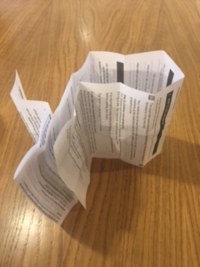

Slide 35
KEEP FIT, GET FITTER – the 5 S Programme
Strength
Stamina
Suppleness
Skill
pSychological

Slide 36
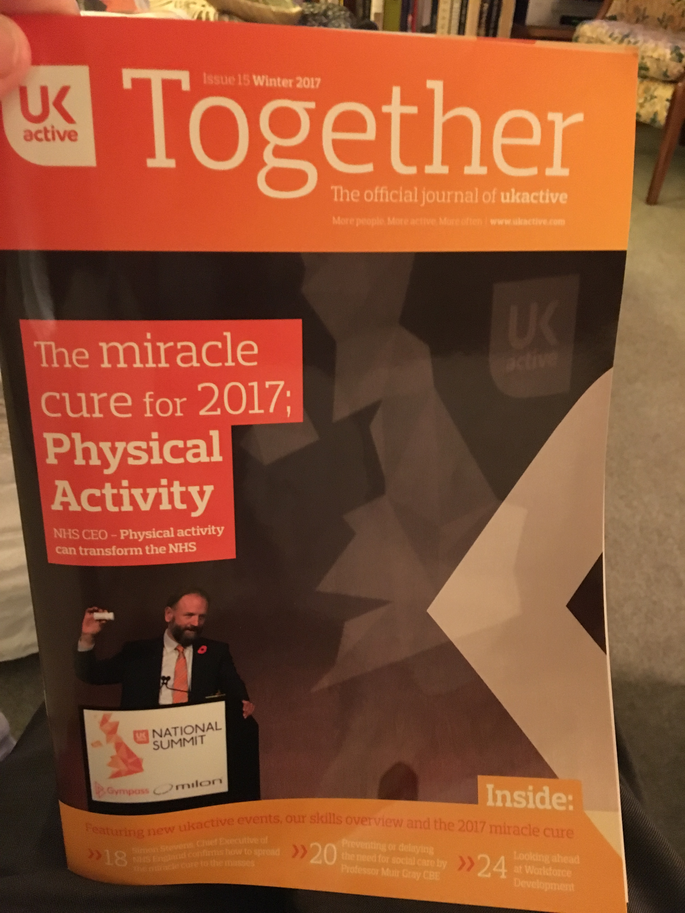

Slide 40
Population physiotherapy would provide leadership
Social Prescribing
NHS
Treatment
Activity
Prescribing
Health
walks
Walking
Plus

Slide 41
?

