Slide 1
Top Tips for Writing Abstracts
Meredith Newman¹, Dr Charikleia Sinani ^{2,3}, Yasmin Edwards¹
1.Chartered Society Physiotherapy, 2. Consortium Lead of the Yorkshire and the Humber CAHPR and Lead Yorkshire Hub CAPHR (Council for Allied Health Professions Research), 3. Senior Lecturer, York St John University

Slide 2
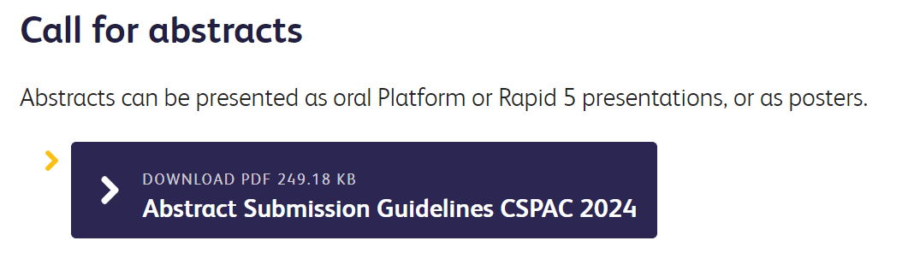
Abstracts - Getting Started
CSP Conference Website
https://www.csp.org.uk/present
Submission guidance
Conference Themes
Sign up to webinars and workshops

Slide 3
Main Conference Submissions
We welcome submissions from people from all parts of the health and social care workforce
Open: 8 January 2024
Deadline: 3 April 2024 at 23:59
Outcome: Mid-May 2024
Presenters must book a ticket to attend conference and present on their allocated day

Slide 4
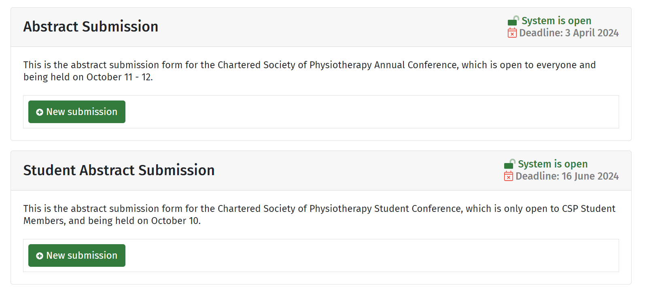
Submission Form
https://csp2024.abstractserver.com/submission/#/login
Support: csp.abstracts@abstractserver.com

Slide 6
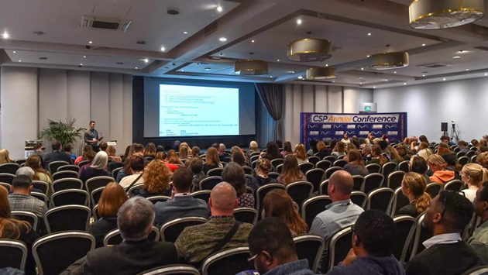
Presentation Type
Abstracts make up a large part of the conference programme.
Platform: oral 15 minutes
Rapid 5: oral 5 slides in 5 minutes
Poster: printed poster and online e-Poster (3 months)

Slide 7
Theme & Methodology
Targeted action
Comprehensive rehabilitation
Building capacity
Transformation and transition
Evolving workforce
Qualitative
Quantitative
Mixed Methods
Service evaluation, clinical audit, service improvement
https://www.csp.org.uk/news-events/csp-annual-conference/conference-themes
Notes:
We ask you to justify your choice of theme - Fit to theme?
As getting the theme right helps to highlight your content to delegates with similar interests and to co-ordinate the programme

Slide 8
Permissions
Ethics
Legal requirement for research with patients
Provide: Ethics body/number/ date.
HRA decision making tool: http://www.hra-decisiontools.org.uk/research/
Audit or Quality Improvement Registration
Note registration number and date
If not needed, justify e.g., systematic review, analysis of published data
Acknowledge Funding
Transparency

Slide 9
Abstract – Sections
Before you begin – read instructions
Title
Purpose,
Methods,
Results,
Conclusions
Potential impact of your project
Remember: you should convey a message
Notes:
Before you begin - Read the instructions for authors. Check any word limit and use the correct font size. Abstracts that don't fit the required format are rejected without being read
Title - The title is important and should attract your reviewers attention. Perhaps leave it until the end when you have decided what you would like to convey. Avoid lengthy titles, and jargon. Use about 10-15 words (one or two sentences) should suffice. Consider including the main topic, population, and setting (e.g. effectiveness of a school intervention programme in improving motor skills in children with DCD) – you can have a question as a title which can capture your reviewers interest but can be risky at the same time (Is early intervention for children with movement difficulties feasible and effective when delivered by support staff with minimal specialist support?)
Purpose - here you need to decide what the purpose of this presentation might be. You may not be able to talk about everything you have done. Therefore, you should make a decision what is that you are trying to convey. You may wish to talk about one aspect of your findings. Your project may have had several aims or objectives but there is not adequate time to talk about it in a presentation or include in a poster. Perhaps ask the question – what is that I am trying to say?
Methods – this needs to be very clear and well structured so if someone reads it they can get a clear idea on how to replicate the work but not in detail though. When writing it have in mind to include the following; design, procedures (search strategy), participant/study characteristics (inclusion/exclusion criteria), equipment/ material or outcome measures (here evaluative tools for SRs) used, outline any statistical/analysis(es) or other analysis (es) used. Be brief and concise.
Results - Give an overview of the findings and provide figures; here I suggest going back to your purpose/ aims and objectives. Do the results link with your purpose? If not, then you have to revise either your purspose/aim or present the data that is relevant to your aim. Studies without any data are not accepted.
Conclusions – This is also an important section of your abstract and you should be as concise as possible. When writing your conclusion consider asking the following questions ·Here, consider addressing the following questions:
Why are your findings important? What is the relevance of your findings with previous work? How is it applicable to clinical practice or other areas? What should happen next?
Potential impact of your project – typically in a conclusion you make suggestions on how this is applicable to clinical practice or other areas. In this case you include this information here. Sometimes, it might seem very hard to understand what the applicability of your project might be. To help you with this I suggest asking the following questions. Will the findings of this project inform diagnosis, assessment, treatment/intervention, pathways to treatment/intervention, service development or delivery? Will the findings of this project inform policy, clinical guidance, education whether that is clinicians or students or management or workforce development? As soon as you know the answer to those questions then you can ask the following: Will these findings be applicable only to my trust or region, national or international? Sometimes the applicability of your work might be a lot more of what you think it might. An experienced researcher can help you with this.
My experience as abstract reviewer, member and chair of the abstract moderation group - too much information or data and lacks focus; these abstracts are hard to follow and are normally rejected.
Remember - you should convey a message/ or as I say a story that someone can follow – someone else to read it / you need that critical eye
To get a better understanding of these sections we will be asking you to review and evaluate 2 abstracts and will be putting you in break out virtual rooms.

Slide 10
Selection criteria
Is the background and purpose of the project clear? (0 – 4)
Is the method or approach clear, does it enable the questions to be answered? (0-4)
Have the results been presented and interpreted appropriately? (0-4)
Are the discussion and conclusions consistent with the results (0-4)
What is the potential impact of this work (0-2)
How would you rate this work overall (0-2)
Notes:
Score per element
Questions 1 – 4 are rated on a scale from 0 to 4. 4 indicates higher score and 0 lower scores.
0 = difficult to follow or understand / not discussed or lacks important and substantial information/ data misinterpreted
1 = unfocused or unclear / limited explanation / brief description or incomplete
2 = mostly adequate but may lack detail or have missed some points
3 = it is very well written across all areas but lacks rigor and detail
4 = rigorous, focused, detailed and replicable with strong conclusions (experience researchers and experts in the area can identify the difference between 3 and 4).
Question 5 about the impact of the work
SCORE 0 = Limited potential impact (cannot be implemented at this stage), SCORE 1 = Has impact, local or defined significance, reach, and benefit (local, parts of it can be implemented, service evaluations are more likely to fit here)
SCORE 2 = Considerable impact, broad significance, reach and benefit (international/ inform policy, guidance or can be implemented)
Question 6 - Overall summary score (this does not necessary need to go hand in hand with the impact – is the topic current, a priority, generates discussion?)
SCORE 0 = Somewhat interesting, needs further development, SCORE 1 = Interesting and valuable, accept, SCORE 2 = Extremely interesting and important, accept as a priority

Slide 11
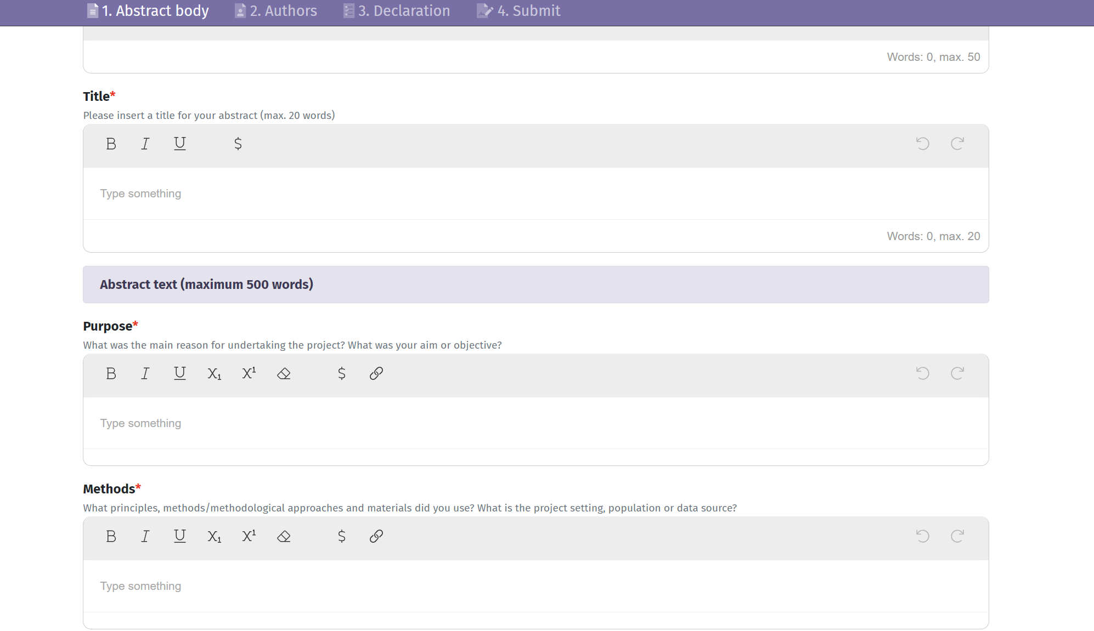
Notes:
Please pay attention to the word count for each section – since it is an online submission, I suggest working on each section in a word document that can be revised at any time prior to each submission

Slide 12
Review
Process
3 independent peer reviews
Summary score (3)*
Ethics check *
Mean score
Moderation panel*
Outcomes
Ranked
< 4.9, no ethics – rejected (%7), 2023 score range 0 - 15
Cut off points for poster and oral presentations vary yearly
Notes:
Talk about the role of the moderation panel including the chair – experienced researchers and very well placed to be in this panel. Individuals are coming from various backgrounds (clinicians, academic, researchers or a combination) that commonly have strong research experience (various methodologies and expertise), some may have served as chairs in ethics committees, reviewed abstracts in this and other conferences and have been involved in scientific committees.
Discrepancy between 3 reviewers will be resolved by the moderation panel – decisions are consistent and the process is quite robust.
The role of the moderation panel is not only to resolve the discrepancy but also discuss and improve the process of reviewing including scoring.

Slide 13
Additional Information
Abstract body – maximum 500 words (can be fewer!)
Keywords
Used to match to reviewer/ programme stream
Searchable – help connect your work to interested delegates via on-line programme
English
Please check spelling & grammar pre-submission (we can’t correct)
Please consider language – abbreviations, ‘people first’ language

Slide 14
Author Information
Key information uses:
Contact you
Chair to introduce you to audience
Bio goes into online conference programme

Slide 15
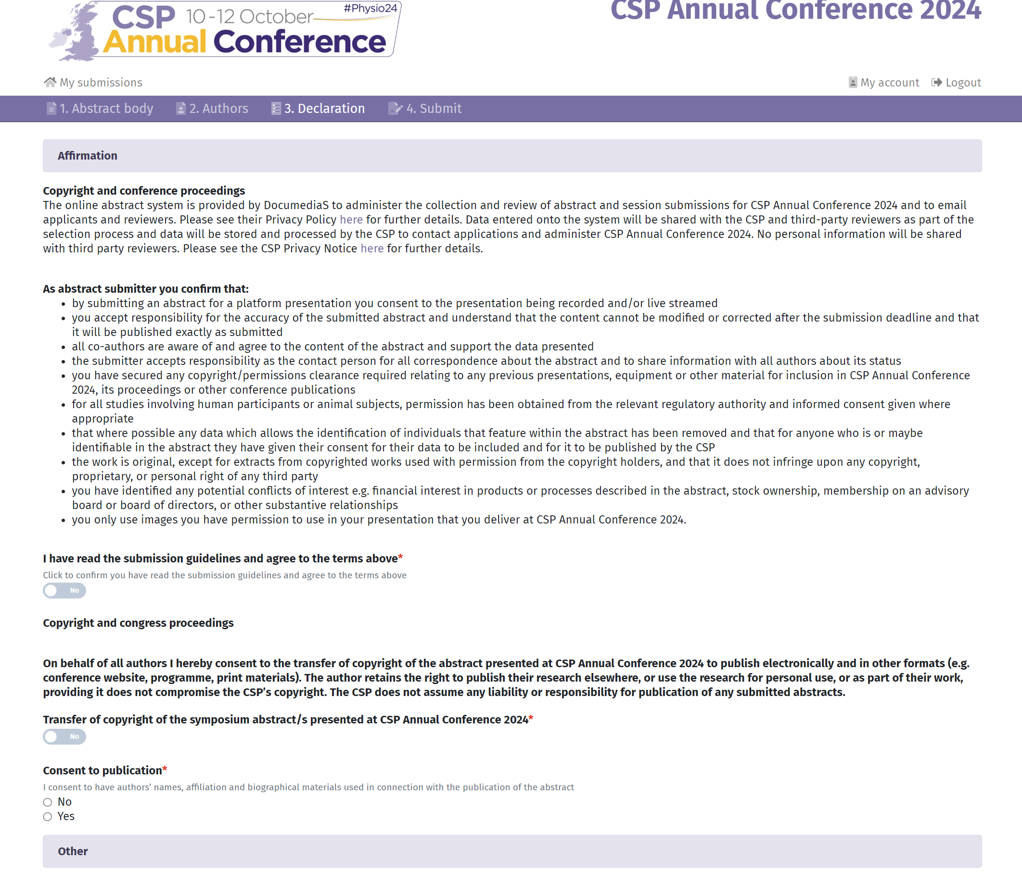
Affirmation
Please read this section
Key information:
Data processing – we cannot accept your abstract without this
All authors agree
Copyright
Original work, non-identifiable data, accuracy of abstract
Publishing – abstract and author names and bios

Slide 16
Submission
Call opens: 8 January, closes 3 April
Submit via online platform managed by DocumediaS
Review and Moderation
April –May
Outcome
Authors advised by email of outcome of submission
Programme
July - Sept
Abstracts with queries sent to Abstract Moderation Group
Abstracts collated and sent to Reviewers to be scored
end May – mid-June
Publication
October - December
10 – 12th October EVENT
Abstracts to Elsevier. Physiotherapy journal conference proceedings
Presenter Resources on conference website
Creating an Outstanding Poster - webinar

Slide 17
Key Takeaway Messages
Check guidelines and use examples
Abstract needs a clear objective, to describe key elements of your approach, to focus on the evidence, tie conclusions to evidence and be easy to read (tell a story).
Seek feedback – a critical friendly eye, fellow co-authors
Sources of support
https://cahpr.csp.org.uk/content/cahpr-top-ten-tips
Local CAPHR Hub
Conference website and team

Slide 18
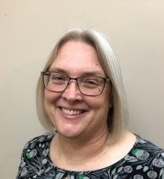
CSP Annual Conference Programme Team
Meredith Newman
Conference Programme Lead
Yas Edwards Conference Programme Coordinator
Sam Fairclough Administration Officer
Conference@csp.org.uk
www.csp.org.uk/present

