Slide 1

Getting Involved in Research
Dr Peter Worsley et al.
Clinical Academic Facility, School of Health Sciences
P.R.Worsley@soton.ac.uk
CSP South Central & Wessex AHSN joint event 2023
Notes:
Top left clockwise – Southampton, Chichester, Brisbane, London, Oxford, University of wente.

Slide 2
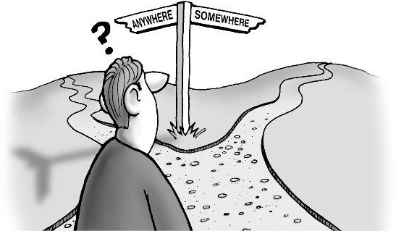
Plan
Summarise the difference between audit, service evaluation, quality improvement and research.
Identify ways to engage with research including:
  a project in practice
  a higher degree
  seeking external funding
  pursuing a clinical academic career
Identify advice and resources that are available to clinicians, when starting out in research.

Slide 3




Can you prove your clinical effectiveness?
Outcome measures
Audit
Patient feedback
Research
Service evaluations
Dissemination

Slide 4


Can you prove….
Successful clinical outcomes?
Positive patient experiences?
Staff consistently use evidence-based practice?

Slide 5
Key differences
Research | Service evaluation & QI | Audit
To generate new knowledge | To define or judge current care | To deliver best care
Addresses clearly defined questions, aims and objectives | Measures current service without reference to a standard | Measures against a standard
Usually involves collecting data additional to routine care | Usually involves analysis of existing data, but may include administration of interview or questionnaire | Usually involves analysis of existing data, but may include administration of interview or questionnaire
May involve randomisation | No randomisation | No randomisation
Normally requires Research Ethics Committee review | Does not require Research Ethics Committee review | Does not require Research Ethics Committee review
After HRA, 2016

Slide 6
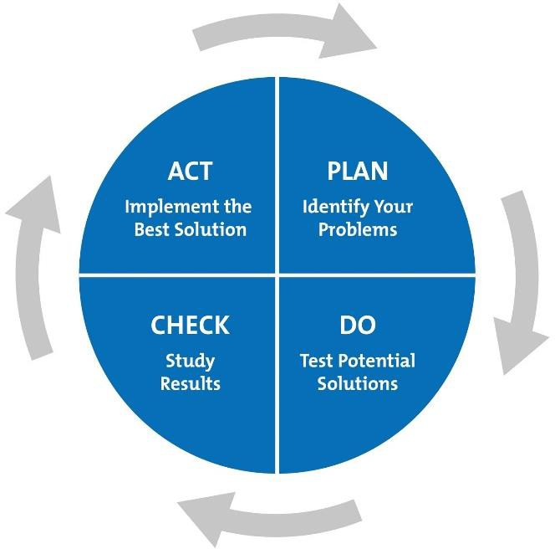
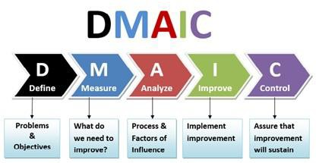
Quality improvement
Community of Safety & Improvement Practice (CSIP) & the Wessex School of Quality Improvement
www.hee.nhs.uk/wes

Slide 7
‘Research is a high-hat word that scares a lot of people. It needn’t... it is nothing but a state of mind, a friendly welcoming attitude to change… going out to look for change instead of waiting for it to come. Research is an effort to do things better. It is the tomorrow mind instead of the yesterday mind.’
(Charles F Kettering)

Slide 8

Getting started in research
Undertake a piece of work in practice eg. review
Joining a research team
Internship
Undertaking a higher degree
Seek funding
Pursuing a clinical academic career

Slide 9

Accessing library sources
Academic librarians
Searching electronic databases AND grey literature
Register for a module in research methods?
Internet searching is a poor substitute for bibliographic databases (& should not be the sole search strategy!)

Slide 10


I want to do a higher degree. Should I do an MSc, MRes, MPhil, DClin P or PhD?

Slide 11


Routes to becoming a clinical academic
National Institute for Health Research pathway
https://www.nihr.ac.uk/explore-nihr/academy-programmes/hee-nihr-integrated-clinical-academic-programme.htm
Fellowships developed with NHS Trusts
Awards from charities eg. Arthritis Research UK

Slide 12

Dissemination

Slide 13

Writing for publication
Decide on your audience
Choose a journal
Discuss with editor?
Plan your paper – how many sections / paragraphs etc
Check if there are relevant guidelines for reporting your methods
Write it
Get feedback from peers
www.caricatures-ireland.com/blog

Slide 14
Guidelines for reporting different types of studies (See www.equator-network.org/)
Type of study | Reporting guideline | Acronym
Systematic reviews | Preferred Reporting Items for Systematic Reviews & Meta-Analyses | PRISMA
Randomised trials | Consolidated Standards of Reporting Trials | CONSORT
Observational studies | Strengthening the Reporting of Observational Studies in Epidemiology | STROBE
Diagnostic / prognostic studies | Standards for Reporting of Diagnostic Accuracy Transparent reporting of a multivariable prediction model for individual prognosis or diagnosis | STARD TRIPOD
Qualitative research | Standards for Reporting Qualitative Research Consolidated criteria for reporting qualitative research | SRQR COREQ
Case reports | Case report guidelines | CARE
QI studies | Standards for Quality Improvement Reporting Excellence | SQUIRE
Economic evaluations | Consolidated Health Economic Evaluation Reporting standards | CHEERS
Study protocols | Standard Protocol Items: Recommendations for Interventional Trials Preferred Reporting Items for Systematic Reviews & Meta-Analyses - Protocols | SPIRIT PRISMA-P
Clinical practice guidelines | Appraisal of Guidelines, Research and Evaluation Reporting Items for practice Guidelines in HealThcare | AGREE RIGHT

Slide 15

Dispelling myths
Research is not only for those who aspire to be consultants or educators
Research is not superior to audit, service evaluation or
quality improvement
Audit, service evaluation and quality improvement projects
can be published
Quantitative research is not superior to qualitative

Slide 16

What will you add to the evidence base of your profession?
Clinical audit
Service evaluation
Quality improvement project
Research
Higher degree: MRes, MSc, MPhil, DClin, PhD
Publication
Conference presentation

Slide 17
Resources to get you going!

Slide 18
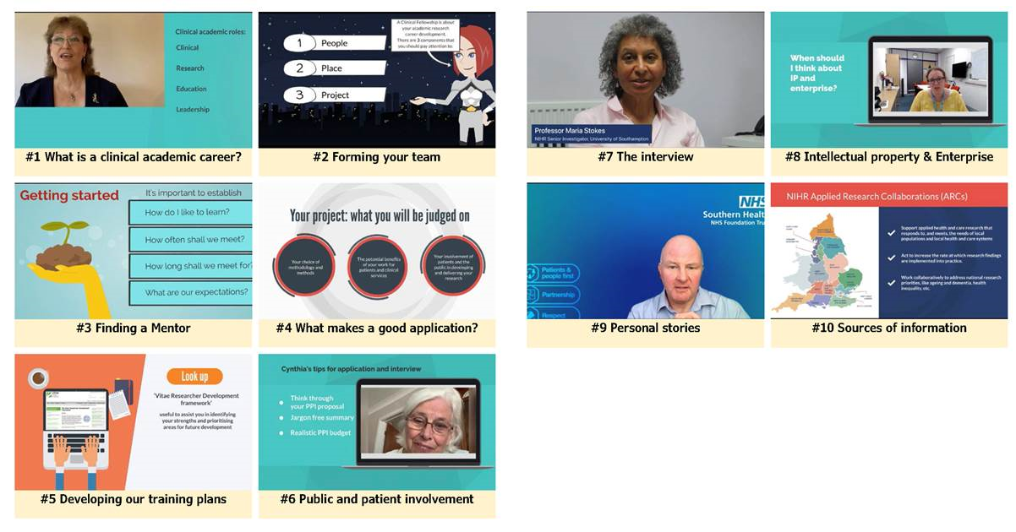
A guide to starting out in clinical academic research
https://vimeo.com/showcase/9710034

Slide 19
Local opportunities
Southampton Academy of Research (SOAR) ‘nurture the potential of our research workforce’ https://www.soar-southampton.org/
The Academy of Research and Improvement (Solent NHS trust) ‘Growing a culture of improvement and learning’ https://www.academy.solent.nhs.uk/improvement
Southern Health https://www.southernhealth.nhs.uk/about-us/trust/quality-improvement
Hampshire hospitals https://www.hampshirehospitals.nhs.uk/our-services/az-departments-and-specialties/research-department

Slide 20
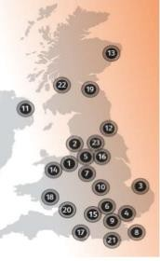
Local resources
Council for AHP Research (CAHPR)
Cheshire & Merseyside Cumbria & Lancashire East Anglia Essex Greater Manchester Hertfordshire Keele Kent & Medway London Midlands Northern Ireland North East England |  | North of Scotland North Wales Oxfordshire South Yorkshire Southern Central South, Mid & West Wales South East Scotland South West England Surry & Sussex West of Scotland Yorkshire
http://cahpr.csp.org.uk/regional-hubs-contacts

Slide 21
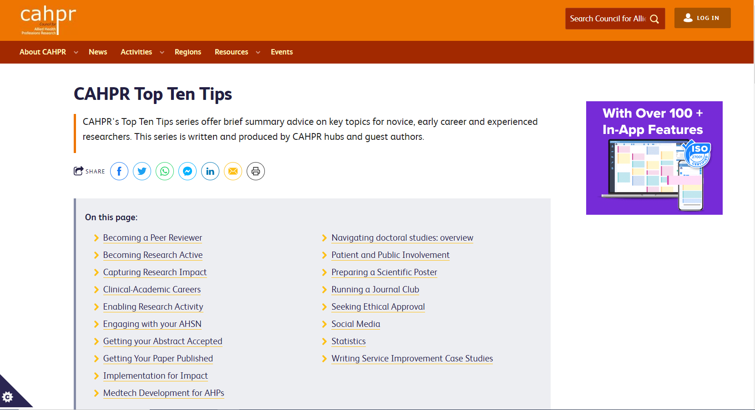
CAHPR resources
https://cahpr.csp.org.uk/content/cahpr-top-ten-tips

Slide 22
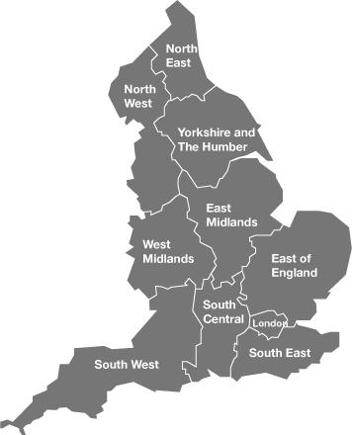
Local resources
NIHR Research Design Service (RDS)
http://www.nihr.ac.uk/about-us/how-we-are-managed/our-structure/research/

Slide 23

Research Design Service
Provide free design and methodological support to health and social care researchers who are developing applications to NIHR and other national, peer-reviewed funding programmes
Access to RDS you can:
  Complete an online request form for individual advice or consultation https://www.rds-sc.nihr.ac.uk/request-support/
  Visit during drop-in sessions to discuss emerging ideas for research
  Guidance and resources on the website https://www.rds-sc.nihr.ac.uk/
  Attend events and seminars

Slide 24
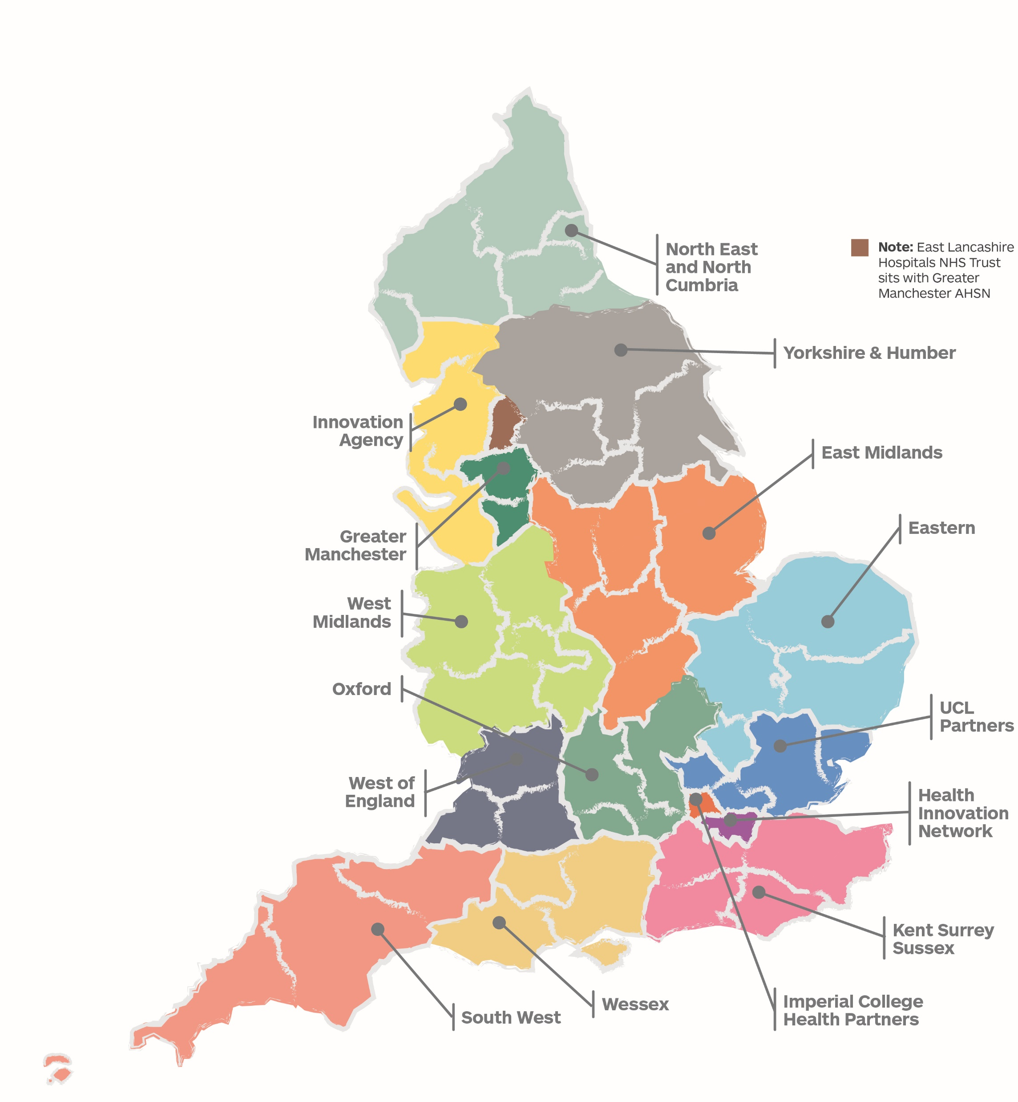
What is the AHSN Network?
Nutrition in Older People programme
Funded by NHS England and the Office for Life Sciences, AHSNs bring together the NHS, industry, academic, third sector and local organisations. Our collaboration ensures innovations, improvements and best practice benefit more patients faster.
There are 15 AHSNs across the county, improving health and generating economic growth. Each AHSN is agile and responsive, whilst staying highly connected to spread innovation at pace and scale. For further information on Wessex AHSN please visit: https://wessexahsn.org.uk/about-us or email enquiriesahsn@wessexahsn.net to connect with the team.
Launch of Healthy Ageing Programme: Scoping, review of potential innovations and request to address more basic issues, first Wessex Acute Frailty Audit
Build local networks and pan-Wessex projects to address local need. Launch hydration e-learning nationally and Nutrition Wheel. Co-leading National AHSN Healthy Ageing Network meeting
Supporting the Covid-19 response
Ongoing building of system relationships, and increased work with regional and national networks
Build national, regional NHS and care recognition. National launch of frailty e-learning. Growth across voluntary sector
Further growth of networks and national alignment. Foundation work now leading to embedding digital innovation approaches

Slide 25






6
The AHSN Network Impact Report 2021-22
National impacts 2021-22
More than 480,000 patients benefited from our national programmes and initiatives
Almost 40,000 hours
of health and care staff capacity
released through our national workforce programme
4,159
interactions
with companies
2,438
companies
supported
1,273
innovations in
our national pipeline of innovation
More than 286,000
people supported at home with
technology-enabled remote monitoring through the National Innovation Collaborative
£455m
investment leveraged
by companies supported by AHSNs
565
jobs created and
1,296
jobs safeguarded

Slide 26

The AHSN Network Impact Report 2021-22
Accelerating patient access to NICE-approved technologies and treatments
The AHSN Network work in partnership with NHS England and NHS Improvement’s Accelerated Access Collaborative (AAC), to bring together industry, Government, regulators, patients and the NHS to remove barriers and accelerate the adoption and spread of new treatments and diagnostics which can transform care.
In 21-22, we supported multiple technologies and treatments as part of the AAC’s Rapid Uptake Products (RUPs) programme and NHS England and NHS Improvement’s MedTech Funding Mandate policy.

Slide 27
Applied Research Collaborations (ARCs)
Scope
5 year (initial) award of £9M. Recently
extended to 31st March 2026.
Links universities with wider health and care system
Range goes well beyond NHS to local
authorities, other social care providers including voluntary and community sector [Integrated Care Systems]
Remit
Generate research evidence – regional priorities
Increase research capacity & capability
Mobilise knowledge – support translation
Engage and involve public members
Work with other infrastructures & networks

Slide 28




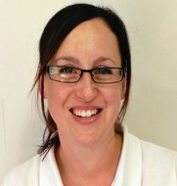
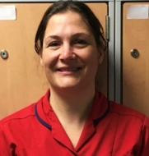
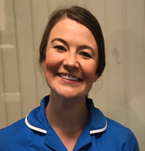







NIHR ARC Wessex
Wessex
Universities
NHS Trusts
in Wessex
Partnering with NIHR infrastructure
Voluntary
organisations
Industry partner
4
10
1
All
Mental Health Research Hub
Collaborations
South East RDS
Wessex AHSN
CRN Wessex
NHSEI
Southampton BRC
Health Education England
Southampton Academy of Research
ARCs
Wessex Patient & Public Involvement Network
ARC Wessex
Research programme
Ageing & Dementia
Long-term Conditions
Workforce & Health Systems
Healthy Communities
Academic Career Development
growing research capacity
NIHR Academy nursing & midwifery incubator support office
Social Care
50
Internships
Round 7 of
Internships
with HEE
7
PhD Awards
8
Ageing, Dementia & Frailty National Priority Research Programme Consortium
Post doctoral awards
8
Cross-ARC Dementia Programme

Slide 29
The research pipeline for the Wessex region
Each part of the local research pipeline, from discovery and invention, to diffusion and widespread implementation.
FUNDED BY | DISCOVERY | EVALUATION | ADOPTION | DIFFUSION
National Institute for Health and Care Research (NIHR)
National Institute for Health and Care Research (NIHR) & Cancer Research UK
NHS England & Office for Life Sciences
UK Research and Innovation (UKRI)
Clinical Research Network Wessex
Research Design Service South Central/South West
Applied Research Collaboration Wessex
Southampton Biomedical Research Centre
Southampton Clinical Research Facility
BioResource Centre
School for Primary Care Research
Southampton Experimental Cancer Medicine Centre & Clinical Trials Unit
Wessex Academic Health Sciences Network
Medical Research Council Lifecourse Epidemiology Centre

Slide 30
The NIHR research ecosystem mapped onto Wessex AHSN Innovation pathway
Invention
Evaluation
Adoption & spread
Early-Phase Clinical Research
Late-Phase Clinical Research
Applied Research & Evaluation
Southampton Biomedical Research Centre, Clinical Research Facility, BioResource Centre & Experimental Cancer Medicine Centre
Applied Research Collaboration Wessex & School for Primary Care Research
Wessex Clinical Research Network (renamed Research Delivery Networks (RDN) from 4/24) & Research Design Service South Central/South West (Renamed Research Support Service (RSS) incorporating CTU support from10/23)
Validation generation
Commer-cialisation
Procure-ment
Brokering
Adoption
Markets
Ideas & IP
Clinical expertise
Value proposition
Real world evidence
Trials & evidence
Health economics
Business care
Scale-up
Success
Culture
Unmet needs
PPIE
Regulatory approval
Finance
Discover
Develop
Deploy

Slide 31
Questions?

