Slide 1
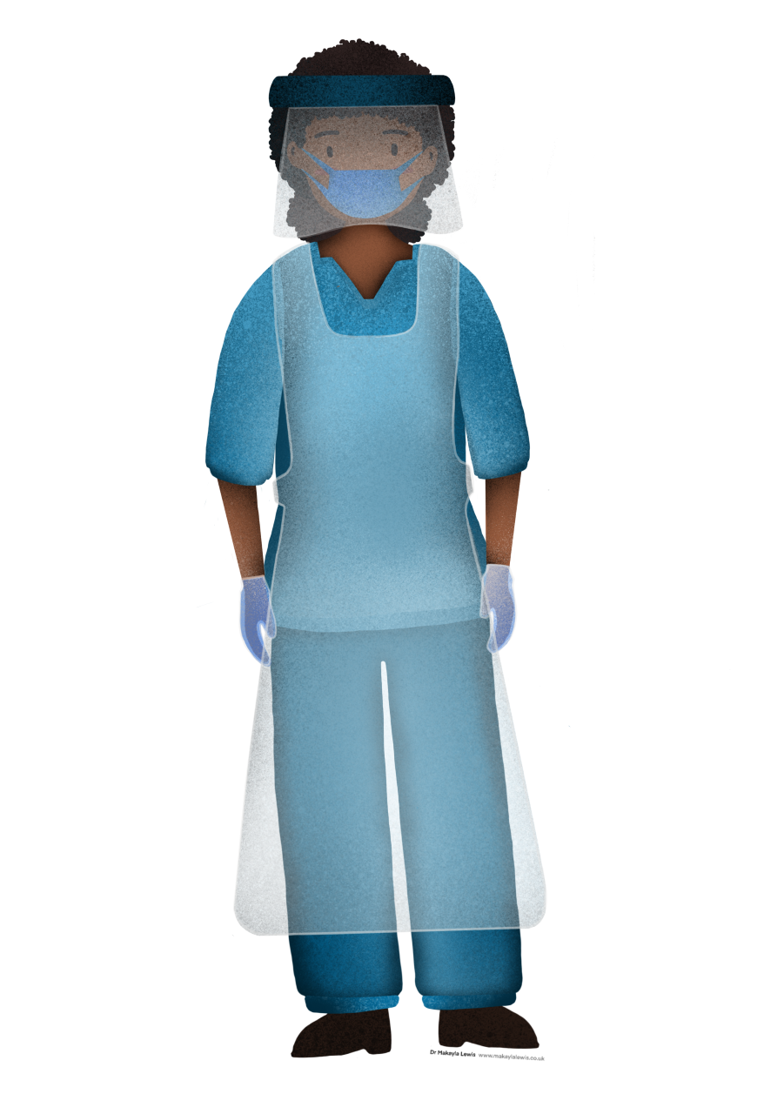
Self-care, resilience and preventing burnout
#SelfCareMatters

Slide 2
Housekeeping
Please mute your microphone
Use chat function to raise questions - we can’t see you all!
Full & frank discussions but please no mention of individual names
Please share your thoughts, tips and advice in the chatroom and with your fellow members
This main part of the webinar is recorded, but the Q&A will not be recorded.

Slide 3
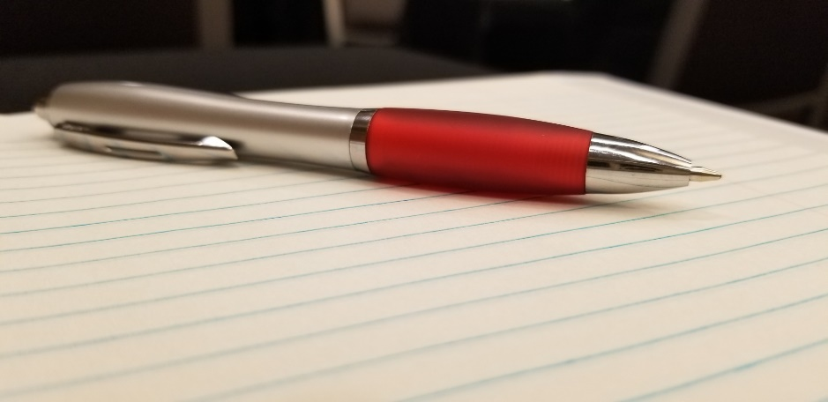
Aims of the session
Provide an overview of self-care, resilience and burnout using a central theme of psychological personal protective equipment
Acknowledge the reality of self-care, resilience and burnout and toxic positivity associated these concepts
Provide useful takeaways
Please have a pen and paper to hand for some activities with Sudhir

Slide 4
Before we start … how are you feeling?
Please go to www.menti.com and type in the following code:
51 54 255
How are you feeling?
What do you think has the most impact on your mental wellbeing?

Slide 5
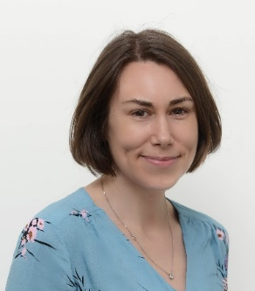
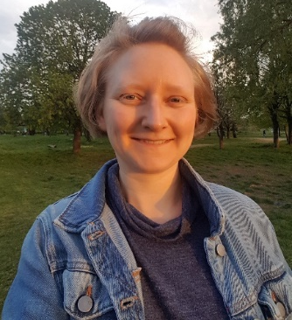
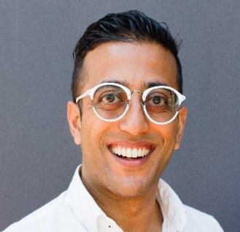
Welcome to our speakers
Emma is a mental health nurse with over 20 years of experience across a wide range of health, emergency care and criminal justice settings. She is currently Head of Mental Health Nursing NHSE/I National Clinical Lead COVID-19 Mental health, Learning Disability & Autism Response cell and continues to work as a consultant Nurse in a local Psychiatric liaison service. Emma is leading the national program of work on reducing suicides in Nursing and Midwifery. Twitter @NursingEmma
Emma Wadey
Miriam is a transformational life coach and lecturer at Queen Mary University of London (Bart’s & the London Medical School), leading on Communication Skills and Quality Improvement for the Physician Associate Studies MSc. She started out professional life as a junior doctor, before discovering a love for education and for helping individuals and teams work out their inner challenges in order to build fulfilling and connected working lives. www.miriamfine.com, Twitter @fine_miriam
Miriam Fine
The Life Architect is a human potential & behavioural science consultancy offering life and executive coaching and training that aims to empower people to design and construct the lives they want to live. It specialises in life vision and fulfilment and has a current focus on equality, diversity and inclusion. www.thelifearchitect.co.uk, Twitter @sudhir_daya
Sudhir Daya

Slide 6
Top Tips from speakers
Nurture body to nurture mind (e.g. sleep, sustain your microbiome)
Regular check-in with thoughts & feelings
Soothe your soul
Find out what resources & support is available locally & nationally
Externalise thoughts to gain perspective
Stimulate your Vagus nerve
Be kind to yourself, it’s okay not to be okay
Speak to yourself as you would speak to your best friend
Save into your emotional bank account

Slide 7
Useful resources*
https://mhfaengland.org/
https://www.csp.org.uk/frontline/article/physio-burnout
https://www.hse.gov.uk/stress/assets/docs/stress-talking-toolkit.pdf
https://www.nhsemployers.org/news/2020/03/free-access-to-wellbeing-apps-for-all-nhs-staff
Headspace app
https://www.practitionerhealth.nhs.uk/wellbeing-app
https://www.psychppe.org
https://resilientpractice.co.uk
*Please note these resources are not endorsed by Chartered Society of Physiotherapy

Slide 8
Blog
For a recap of what was covered in the 24th November event, check out my blog: https://www.miriamfine.com/blog-1
Podcasts
By The Book – This a comedy podcast where 2 friends choose one self-help book each episode, live by it for 2 weeks, and weigh in on whether it actually changed their lives. It’s a light-hearted way to start hearing about various ideas – this episode explores the idea of getting to know your inner narrator (‘What to say when you talk to yourself’):
https://www.stitcher.com/show/by-the-book/episode/what-to-say-when-you-talk-to-yourself-200144613
Unlocking Us with Brené Brown – Shame researcher Brené Brown hosts different guests for interesting discussions about different elements of the human experience. Highly recommend this episode: Brené with Emily and Amelia Nagoski on Burnout and How to Complete the Stress Cycle https://www.stitcher.com/show/unlocking-us-with-brene-brown/episode/brene-with-emily-and-amelia-nagoski-on-burnout-and-how-to-complete-the-stress-cycle-78571329

Slide 9
Mindfulness & Self-Compassion
Insight Timer App (free): This app has loads of recorded meditations you can listen to – you can search by length or by theme – and also has a timer with a nice bell if you want to just quietly meditate for a set time. You can also be friends with people over it and encourage each other to keep going.
RAIN (mindful self-compassion) resources. The website also has lots of other resources including guided meditations: https://www.tarabrach.com/rain/
https://self-compassion.org/ - loads of free resources to support and explain the practice of self-compassion.
Hedderman, E. & O'Doherty, Veronica & O’Connor, S.. (2020). Mindfulness moments for clinicians in the midst of a pandemic. Irish Journal of Psychological Medicine. 1-14. 10.1017/ipm.2020.59. Available from: https://www.researchgate.net/publication/341552307_Mindfulness_moments_for_clinicians_in_the_midst_of_a_pandemic

Slide 10
Before we finish …
Please go to www.menti.com and type in the following code:
72 34 402
What are your take home messages from today’s session?
What topics would you like to have for future events?

