Slide 1
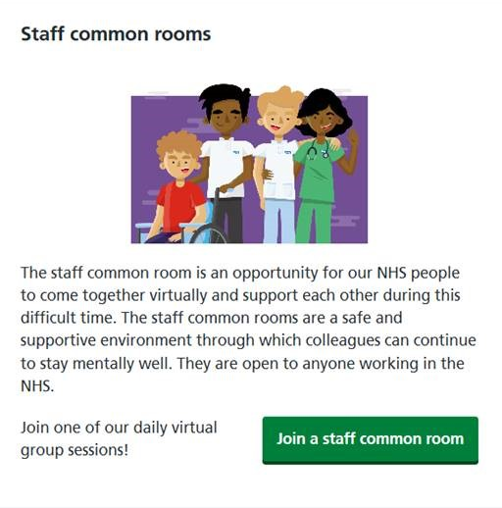
Virtual Staff Common Rooms
The staff common room is an opportunity for our NHS people to come together virtually to help to support each other during these difficult times
They are open to everyone working across the NHS, whatever their role, and whatever their context
They provide a safe, supportive and confidential environment for up to 10 people, hosted by experienced group leaders
By participating in a common room, we hope that people will feel better enabled to maintain their health and wellbeing, to continue to function well, and will have been supported in their ‘natural recovery processes’
To book, visit: https://people.nhs.uk/help/
and scroll down to Staff Common Rooms
In partnership with…..

