Slide 1
Dementia, Carers & Couple Coping
Kelly Warwicker
University of Wolverhampton

Slide 2
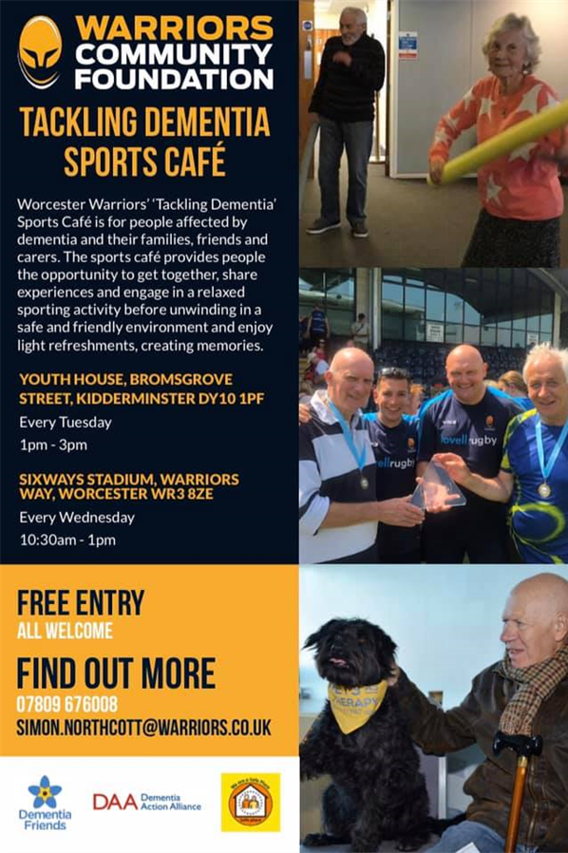
Tackling Dementia Sports Cafe
Spousal Carers
Informal Carer
Dementia Diagnosis
Intervention Development

Slide 3
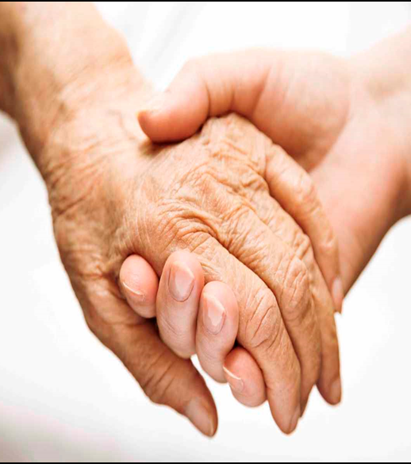
ROLE OF THE CARER
1 in 8 adults (6.5 million people) are carers in the UK
Carers save UK economy £132 billion per year (Av. £19,336 per carer)
By 2037 anticipated increase to 9 million.
Psychological outcomes - Poor

Slide 4
The Caring Transition
Pre caring to caring - life and emotional changes (Corry, Smith, Neenan, & Brabyn, 2017)
Carers are neglected in comparison to other public health issues (Karapliagou and Kellehear, 2016).
The cessation of the role of caregiver is regarded as a significant ‘life transition’ (Coffman, 2001; Fry, 2001; George, 2001)

Slide 5
Dyadic Coping (Couple Coping)
Partner and dyadic coping are important resources within the relationship (Bodenmann, 2005).
Dyadic coping interventions are reported as being beneficial to couples contributing to improved relationship function (Meier, Bodenmann, Moergeli & Jenewein, 2011; Traa, De Vries, Bodenmann & Den Oudsten, 2015).
Social support and particularly the support of significant others contributes to coping with a chronic disease (Meier, Bodenmann, Moergeli & Jenewein, 2011).

Slide 6
support
Need for Interventions
Carers are unique
Coping with changing, challenging, unpredictable circumstances (Whitlatch & Orsulic – Jeras, 2018)

Slide 7
Existing Interventions for Spousal Carers
Emotionally Focused Therapy (EFT)
Partners in Coping Program (PICP)
Coping Skills Training (CST)
Homebased/Coach Led/Self Directed
Supportive Expressive Therapy (SET)
Preliminary Live with Love Conceptual Framework (P-LLCF)
Coping Together
Mindfulness Based Stress Reduction (MBSR)
Patient Dignity Inventory – Clinical Interview (PDI – CI)
Assisted Vacations

Slide 8
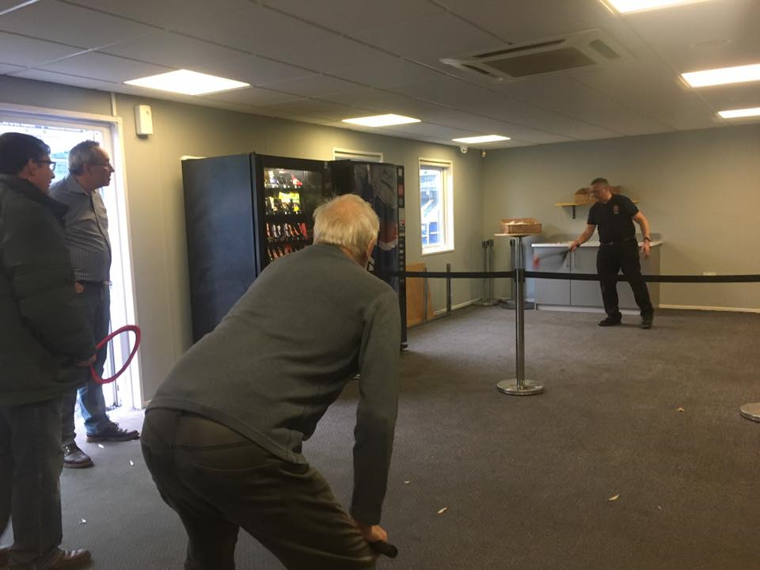
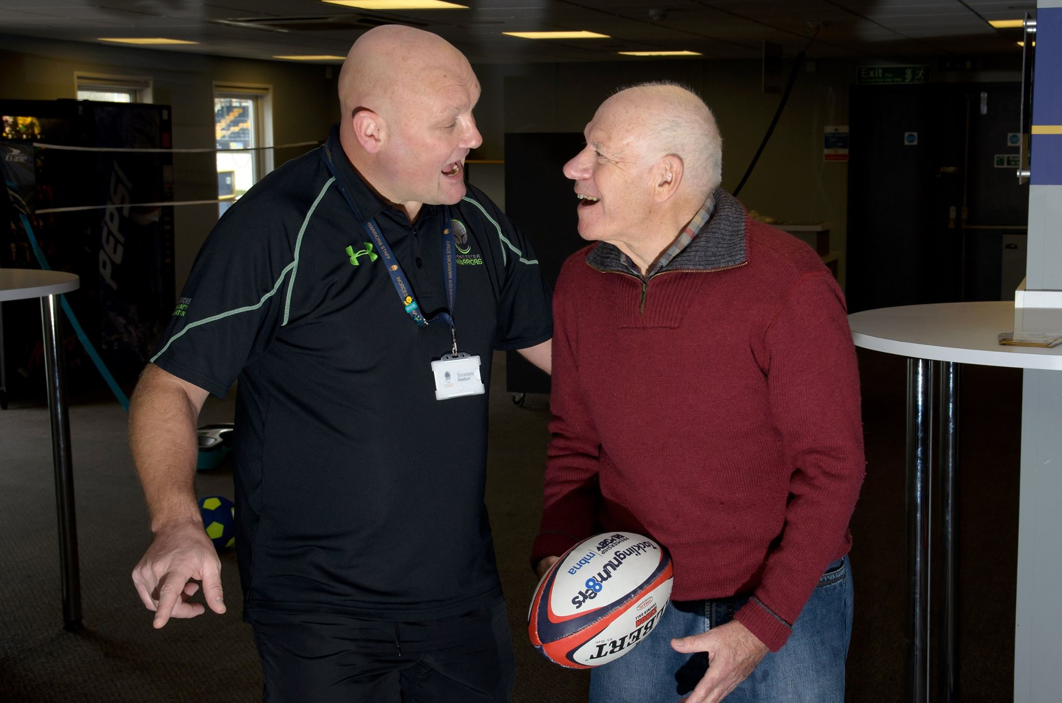
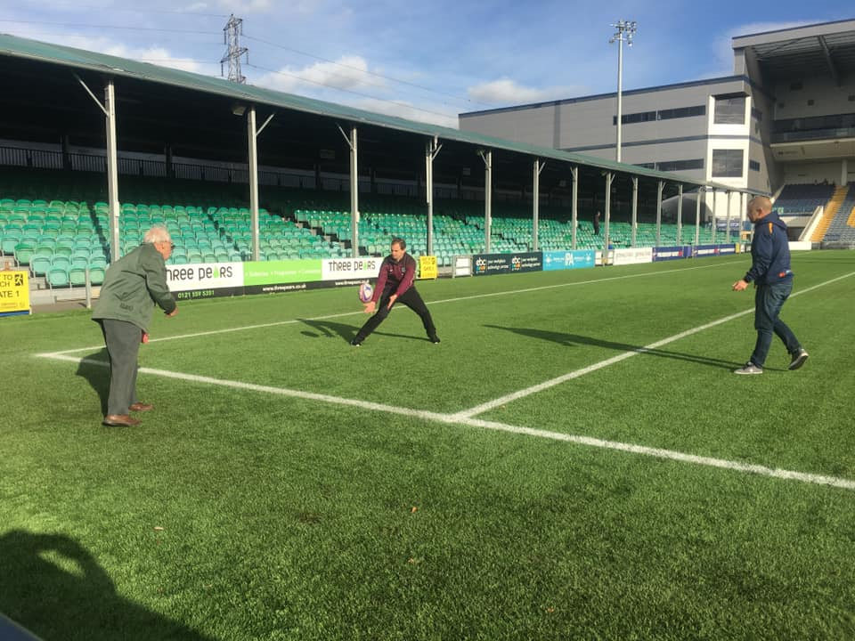
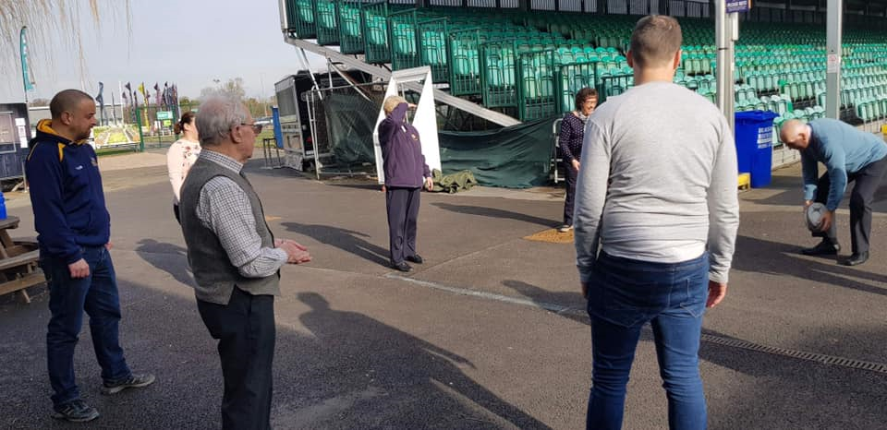
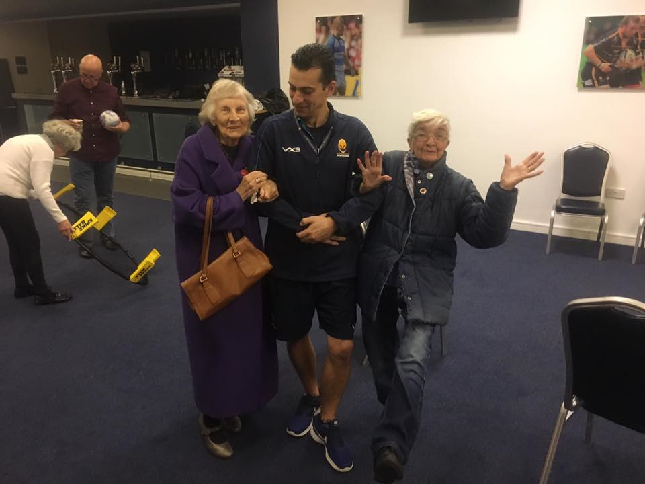
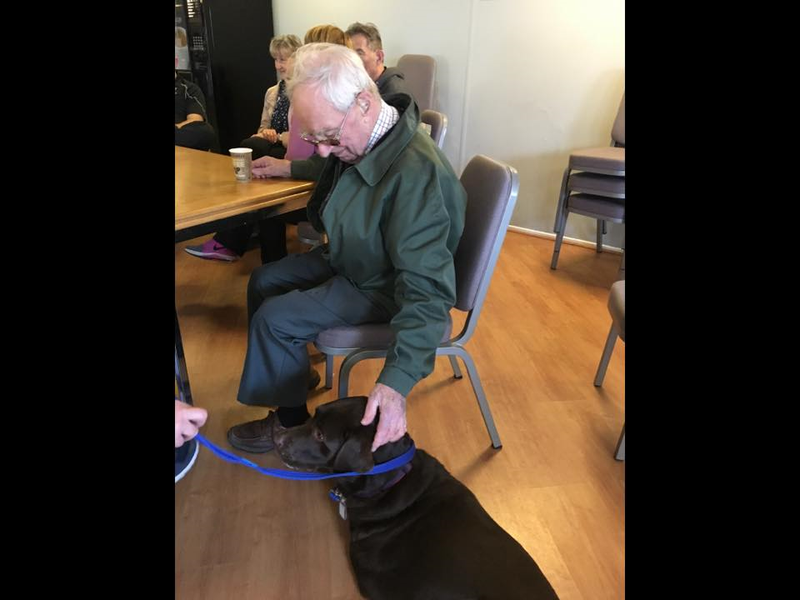
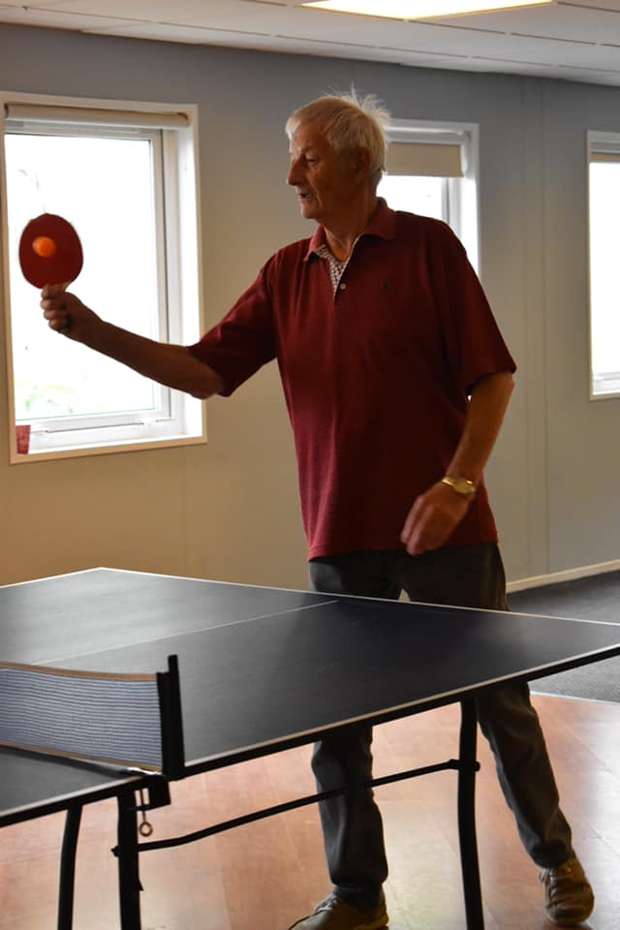
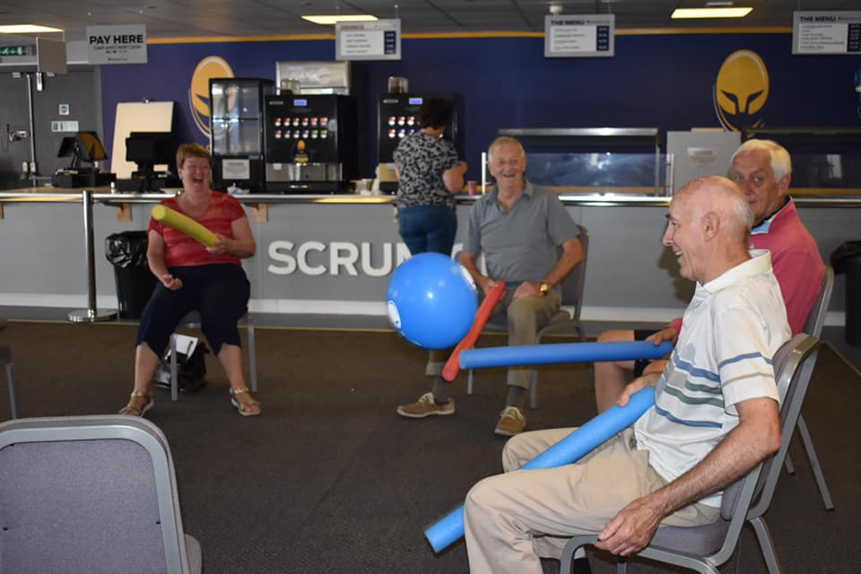
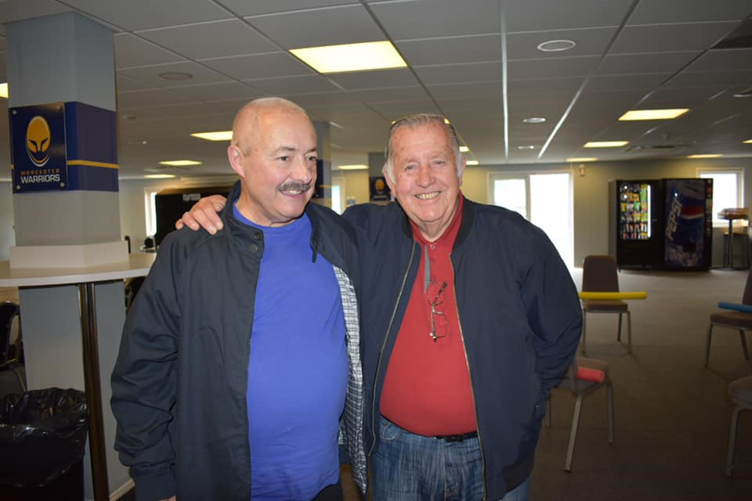
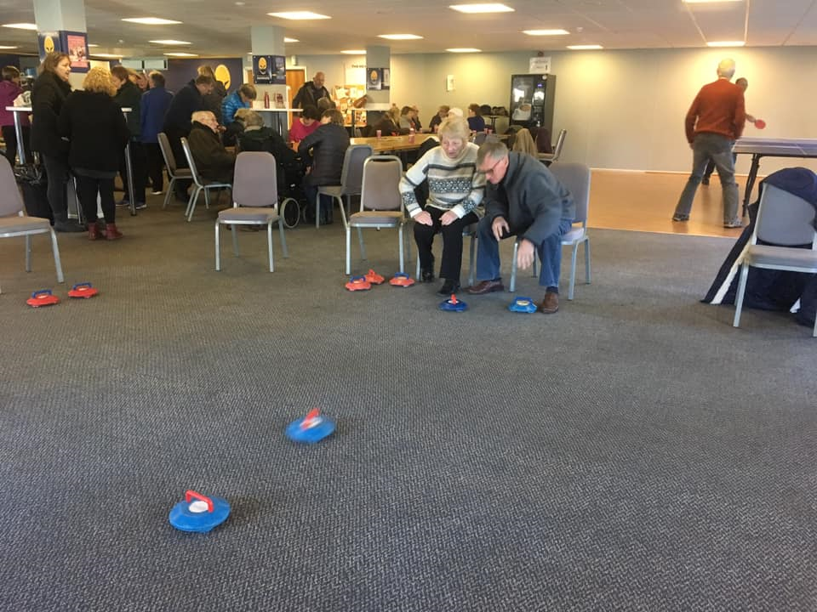
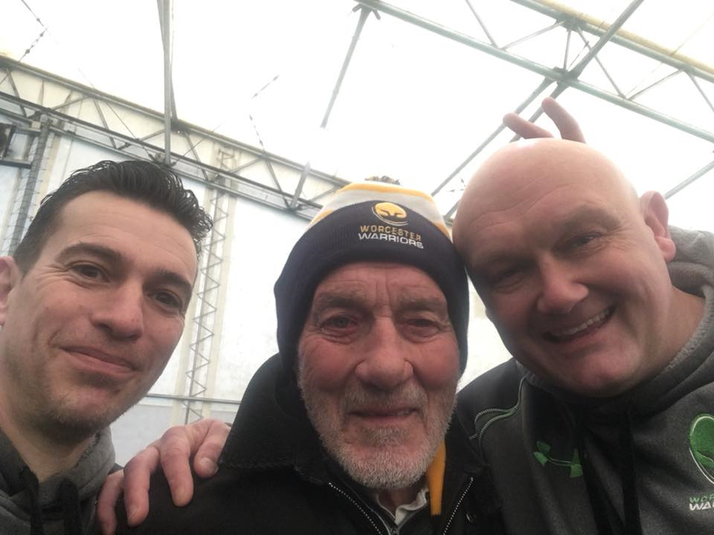
Thriving

Slide 9
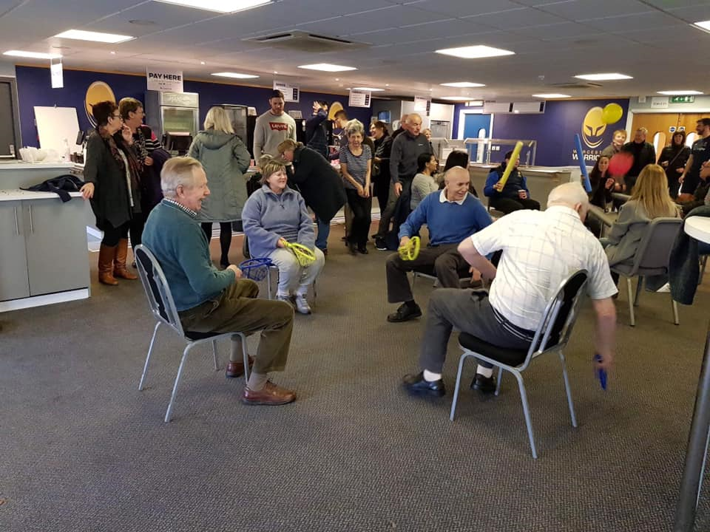
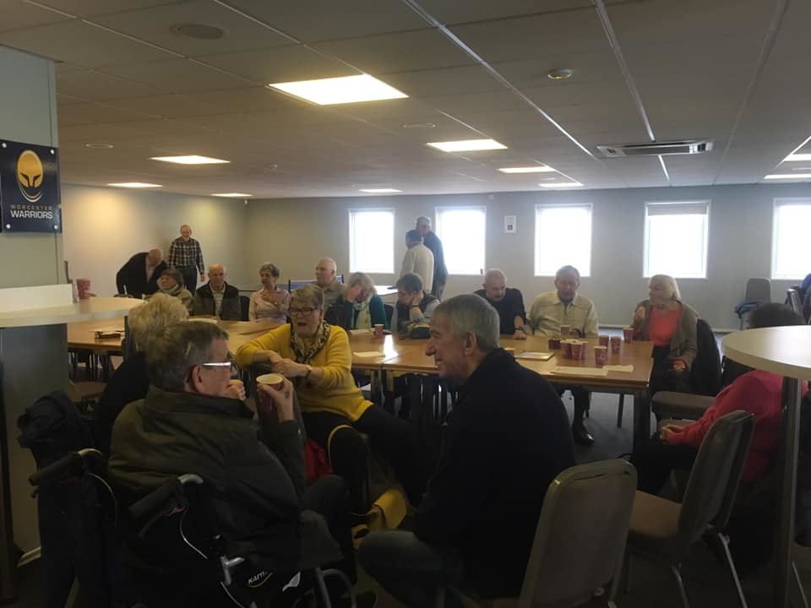
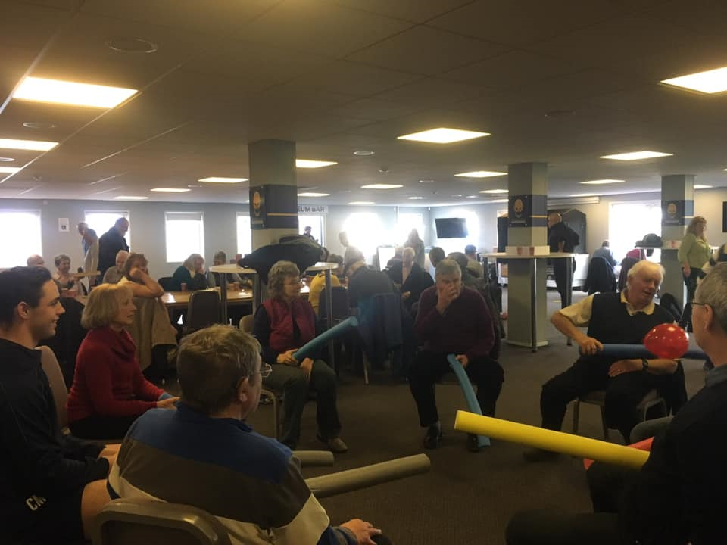
Social networks

Slide 10
Over to chris & simon

Slide 11
References
Bodenmann, G. (2005). Dyadic Coping and Its Significance for Marital Functioning. Couples Coping with Stress: Emerging Perspectives On Dyadic Coping., 33-49. doi: 10.1037/11031-002
Carers.org,. (2014). Carers Trust. Retrieved 29 February 2016, from https://www.carers.org/sites/default/files/care_act_briefing_june_2014.pdf
Coffman, T. L. (2001). Relocation/relocation stress. In G. L. Maddox (Ed.), The encyclopedia of aging (3rd ed., pp. 871-873). New York: Springer.
Corry, M., Smith, V., Neenan, K., & Brabyn, S. (2017). Telephone interventions, delivered by healthcare professionals, for educating and psychosocially supporting informal caregivers of adults with diagnosed illnesses. Cochrane Database Of Systematic Reviews. doi: 10.1002/14651858.cd012533
Fry, P. (2001). Predictors of Health-Related Quality of Life Perspectives, Self-Esteem, and Life Satisfactions of Older Adults Following Spousal Loss: An 18-Month Follow-up Study of Widows and Widowers. The Gerontologist, 41(6), 787-798. http://dx.doi.org/10.1093/geront/41.6.787
George, L. K. (2001). Life events. In G. L. Maddox (Ed.), The Encyclopedia of aging (3rd ed., pp. 596-598). New York: Springer
Karapliagou, A., & Kellehear, A. (2016). The forgotten people in British public health: a national neglect of the dying, bereaved and caregivers. BMJ Supportive & Palliative Care, bmjspcare-2015-000981. http://dx.doi.org/10.1136/bmjspcare-2015-000981
Meier, C., Bodenmann, Moergeli, & Jenewein. (2011). Dyadic coping, quality of life, and psychological distress among chronic obstructive pulmonary disease patients and their partners. International Journal of Chronic Obstructive Pulmonary Disease, 583. doi: 10.2147/copd.s24508
Traa, M., De Vries, J., Bodenmann, G., & Den Oudsten, B. (2015). Dyadic coping and relationship functioning in couples coping with cancer: A systematic review. British Journal of Health Psychology, 20(1), 85-114. doi: 10.1111/bjhp.12094
Whitlatch, C. J. & Orsulic-Jeras, S. (2018). Meeting the informational, educational, and psychosocial support needs of persons living with dementia and their family caregivers. The Gerontologist, 58, S58–S63. doi:10.1093/geront/gnx162

