Slide 1
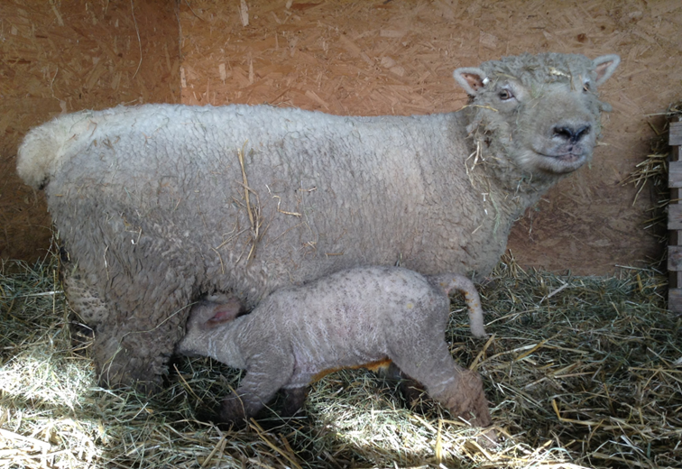
Shepherdess to Band 5
Medway Community Healthcare – Musculoskeletal Physiotherapy Department
Tina Bale - Advanced Technical Instructor
Sarah Spice - Adult Therapy Operational Lead
Notes:
Hello….

Slide 2
Talk Overview
Shepherdess to Band 5 journey
Appropriate training and qualifications
Management support
Progression from Band 4 to 5
Key reflections

Slide 3
Background
Agriculture – Shepherdess
2 years on the job training with day release to Hadlow College.
Transferable Skill; observation.
Theatre Steward/Technician/Manager
1 year technical theatre at Mid-Kent College.
Transferable skills; time management, customer service and management of staff.
Notes:
As far away from people as possible outside in the open!
Chosen career ended due to BSC and foot & mouth
Theatre hobby – something to do.
Colleague suggested physio assistant job

Slide 4
Physiotherapy Assistant Band 2
Sheppey Community Hospital – stroke unit.
Medway Maritime Hospital – elderly care, medical and orthopaedic wards.
Learning was on the job. Assisting physiotherapists with rehabilitation and issuing walking aids.
Notes:
Applied for post successfully
Thought I would do for a couple of years until I found something else.
“Not a huggy kind of girl”
Learning was on the job

Slide 5
NVQ Level 3 in Diagnostic and Therapeutic Support
12 Modules; which included electrotherapy, hydrotherapy and delivering individualised exercise programmes to clients.
Learning was on the job with self directed study. A physiotherapist trained as an NVQ assessor, mentored within the workplace.
Notes:
All band 2’s offered NVQ – hands on qualification in house
1/12 a month in class for 1yr, took 2yrs to complete
Trust physiotherapists trained as NVQ assessors
Case studies for course work

Slide 6
Technical Instructor Band 3
Medway Maritime Hospital
Mornings; Elderly care, medical and orthopaedic wards, rotating every 3 months.
Afternoons; Musculoskeletal physiotherapy outpatients.
Learning was on the job, one-to-one training and IST
Notes:
One to one mobility assessments on wards and follow ups in out patients.
Able to progress treatment programmes without direct supervision of physiotherapist within scope of practice.
One to one training and IST started in outpatients due to variety of conditions being treated – long term, trauma, post op.

Slide 7
Senior Technical Instructor Band 4
Job share in Hydrotherapy & MSK outpatients
Started new patient assessments for joint replacements, OA, arthroscopies, wrist fractures, post operative shoulders – SAD.
Became lead for joint replacements and formed the joint replacement class for TKR/THR.
Job share colleague retired and became lead for hydrotherapy.
Mentoring of band 2, 3’s and apprentices.
Learning was on the job, one-to-ones with senior, IST, action
learning sets, WhatsApp and external courses (APPI Mat work –
self funded).
Notes:
Started Np assessments, lead for JR classes – initial just TKR but then for THR as well.
Colleagues retired and became lead for hydro with a new band 2 to assist running of department.
Pool shutdown due to issues with the foundations, transferred into outpatients full time.
APPI self funded
Learning – action learning sets and WhatsApp group

Slide 8
Foundation Degree in Health and Social Care
12 Modules including; applied human biology, management of long term conditions, promoting active engagement in everyday living and understanding evidence for practice.
Learning was self directed study and day release to university, funded entirely by the workplace. Supported by senior colleague on a fortnightly basis.
Notes:
Nationally recognised qualification
Wasn’t mandatory as already band 4 but I asked to complete the qualification to underpin my current knowledge and skill base and to prove to myself and others that I deserved my band 4 position.
Workplace evidence tool – competencies given by uni
Negotiated module – JR class.
Our department moved out of hospital setting and became a Social Enterprise.

Slide 9
BSc Honours Degree in Applied Health and Social Care
Canterbury Christ Church University: Sept 2015
Inquiry-based approaches
Negotiated work place module
Principles of effective pain management
Review and plan of learning
Transforming practice.
Learning was self directed study and day release (given by employer) to university, funded by self. Supported by senior colleague on a fortnightly basis.
Notes:
Given the opportunity to work towards full degree, asked employer as I was doing well on foundation degree and they agreed study time but I funded myself.
Again to prove to myself that I could achieve a BSc hons degree.
Negotiated module – anterior knee pain
Transforming practice – wrist class

Slide 10
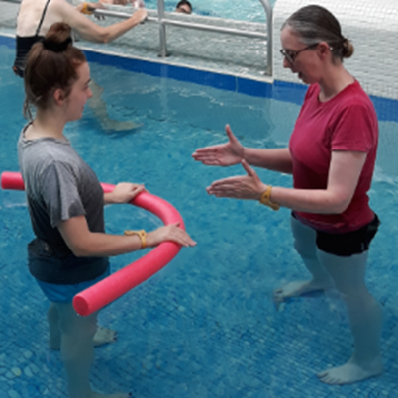
Advanced Technical Instructor - Band 5
Notes:
Completed Level 3 diploma in Teaching Pilates – self funded cost and time!
Mentoring of apprentices, bands 3, 4’s & sports therapy students.
Pass over to Sarah.

Slide 11
Developing support workers at MCH
Notes:
Heard about Tina’s journey from being a shepherdess to a band 5 – I’m here to give an idea of how we achieved that from a management perspective

Slide 12
Creating an environment for growth
Management
Support
Individual
Team
Notes:
Joint effort

Slide 13
The Individual - Tina
Drive, passion and determination
Proactive - Increasing skills and knowledge
Understanding scope of practice
Recognising two-way commitment

Slide 14
Management Support
Supported development and provided funding
IST, 1:1s, action learning sets, study leave, reflections
Recognised value and importance within team
Aim – to retain staff and ‘grow our own’
Notes:
Not funded everything – would love to have endless supply of money but unfortunately we don’t. Match learning with appraisal and PDP

Slide 15
Tina
(B4)
Pilates
Aqua
Talks
JRC
Mentor
NP/FU
Audit
Notes:
Very driven, working at a high level, adding value, asset to the department. £1,000 a month on pilates

Slide 16
How do we reward and progress beyond a band 4 role?
Band 8
Band 7
Band 6
Band 5
How do we break the mould and increase scope for progression?
Band 5
Band 4
Band 3
Band 2
Notes:
Exactly the same as physiotherapists

Slide 17
Challenging conscious and unconscious biases
Challenging language used. Qualified/unqualified
Look at skill sets not job titles
Creative skill mixing within the team
Notes:
When you google what band is a physiotherapy assistant? Start at 2-4, with further training can become band 4.

Slide 18
Variety Vs Quality
Adding value – Quality care, waiting times, income
Budget management - flexibility
Physio within executive team – championing new ways of working
Notes:
But what she does deliver is quality from years of experience and patient miles, never has an empty diary. Raises approx £1,000 a month. Flexibility to invest in staff

Slide 19
Job Descriptions
Reviewed JD
Reviewed similar JDs across
the organisation
Rewrote JD – to reflect current roles and responsibilities

Slide 20
Human Resources
Application for job banding review
Validated against AFC criteria
Consistency checked and matched as a Band 5 role
✓
Notes:
Very important for us to show no favouritism, to ensure equality throughout the organisation
Very important for Tina, it wasn’t just handed to her, she deserved it.
Not one member of staff has ever questioned her becoming a band 5

Slide 21
Anna
Volunteer
Administrator
Band 2 physiotherapy assistant
Band 3 physiotherapy assistant
English and Maths course
Access course
Physiotherapy Apprenticeship

Slide 22
Sarah
Work Experience
Flexi staff – admin/reception
Sports Therapy Student
Sports Therapist within the Department

Slide 23
Key reflections
Look at skill sets not job titles
Creative skill mixing within the team
Two-way commitment
Challenging the bias, unconscious bias & language
Notes:
We have to move with the times and use our assets which are our valuable workforce. Symbiotic relationship

Slide 24
‘The illiterate of the 21st century are not those who cannot read and write, but those who cannot learn, unlearn and relearn’
(Alvin Toffler)
Notes:
Leave you with a quote that I feel is very applicable to our clinical and managerial work as well as our thought processes on support workers

Slide 25
Thank you
Tina Bale
tina.bale@nhs.net
Sarah Spice
sarah-jane.spice@nhs.net
Medway Community Healthcare - 01634 334605

Slide 26
NVQ Level 3 in Diagnostic and Therapeutic Support
Bexley College: May 2003
- Promote peoples equality, diversity and rights
- Promote, monitor and maintain H&S in the workplace
- Develop one’s own knowledge and practice
- Contribute to the development and effectiveness of work teams
- Prepare and restore the client and environment prior to and following physiotherapy
programmes
- Support others in the implementation of physiotherapy programmes and treatments
- Assist with and carry out agreed physiotherapy mobility and movement programmes
- Prepare and apply agreed hydrotherapy programmes
- Promote effective communication and relationships
- Support inter-disciplinary teams in delivering individualised programme to clients
- Contribute to raising awareness of health issues
- Enable individuals, their family and friends to explore and manage change.
Notes:
All band 2’s offered NVQ – hands on qualification in house
1/12 a month in class for 1yr, took 2yrs to complete

Slide 27
Foundation Degree in Health and Social Care
Canterbury Christ Church University: July 2013
- Applied human biology for health care workers
- Contemporary health issues
- Management of long term conditions
- Personal, academic and workplace development
- The social context of health
- Infection prevention/tissue viability in professional practice
- Changing workplace practice
- Contemporary issues in ethics and law for practice
- Negotiated learning module
- Promoting active engagement in everyday living
- Understanding evidence for practice
- Understanding human development through the life stages.
Notes:
Nationally recognised qualification
Wasn’t mandatory as already band 4 but I asked to complete the qualification to underpin my current knowledge and skill base and to prove to myself and others that I deserved my band 4 position.

