Slide 1

Karen Middleton
CEO
Chartered Society of Physiotherapy
Notes:
Introductory slide
Thanks to SEC network for opportunity to speak
What I hope you will get out of the day
Managers:
To recognise the CSP's commitment to the development of Support Workers; the benefits of support workers having CSP membership and being released for CSP led events
Associates:
To feel that as CSP Members they can count on our support, and even more support going forwards; the CSP is fighting their corner; the CSP and its members recognise the value of Associates & SWs; it is worth continuing their membership as exciting developments are ahead
Non Member Support Workers:
To feel they really need to join the CSP otherwise they will miss out!; they will feel inspired to be part of a community with the CSP at the forefront of national physiotherapy development; the CSP is there to support them and recognises their value; they can feel proud to be a member of the CSP

Slide 2
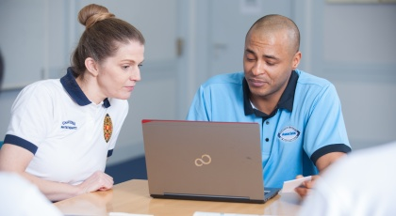
THE CHARTERED SOCIETY OF PHYSIOTHERAPY
The UK’s only professional, educational and trade union body for chartered physiotherapists, physiotherapy students and support workers.
Transform lives
Maximise independence
Empower populations
Our vision:
Notes:
Who are the CSP?
We welcome all support workers who undertake some delegated physiotherapy as part or all of their role into our Associate membership category
As an Associate members you enjoy all the benefits of CSP membership

Slide 3



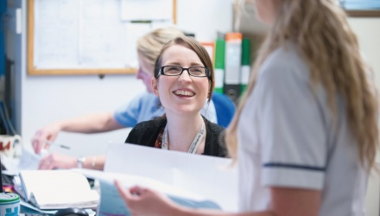
The Future of the Physiotherapy Profession and Our Workforce
Notes:
Aim of this keynote is to share with you the CSP position on the direction of travel for our profession and our workforce
Explicitly share where support workers feature in this
The UK physiotherapy profession needs to grow, develop and lead change for the health and care system to meet future population and patient needs in effective, sustainable ways.
Population ageing, working longer, more of us living with multiple long term conditions – huge demand on the profession but also an opportunity
This needs more of us (might want to mention increase in student training places in England)
This is not more of us doing the same – it is more of us working differently
In particular – as expert advisors; as public health champions; as first contact practitioners and as advanced practitioners; as leaders of health and care services; as leaders in supporting patients to self-manage; as practitioners whose practice is enabled by technology and as an evolving agile and versatile solution to contemporary health and care challenges
This is not a story about the growth and development of the registered workforce. It’s about the growth and development of the entire workforce
Support workers play a significant part in the provision of safe, high quality physiotherapy care. We see, in the future, they will play an even bigger part and their roles will be even more crucial, we simply cannot realise the ambitions for the profession without them

Slide 4
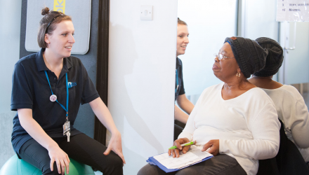

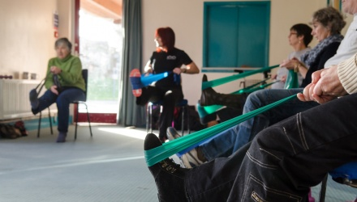
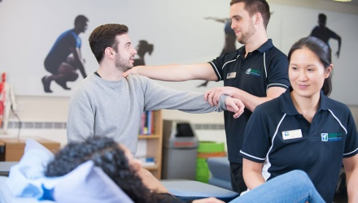
Physiotherapy Support Workers
Growth to 35% of the total physiotherapy workforce
Right level of knowledge and skill in the right place
Entire workforce working to top of their capability and scope
Notes:
In particular we see support workers working in new and innovative roles and more support workers practicing at higher levels. Currently non registered workforce is 15% of whole. CSP believe this needs to increase to the same as nursing (35%) at least.
This is not about substitution. This is about scrutinising current practice to be sure the right person with the right level of knowledge and skill necessary to meet need is in the right place at the right time in the patient pathway. This about everyone working to the height of their capabilities and letting go of roles that can be performed as effectively by others.

Slide 5
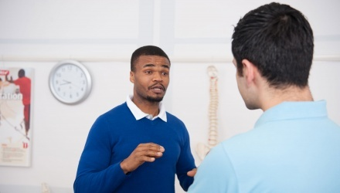
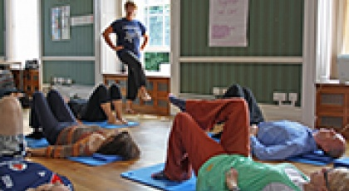
Increased delegation within a robust governance framework
New roles and more at higher levels
Greater role supporting learners in practice
Physical activity champions supporting behaviour change
Greater role in education and advice
Notes:
Support workers will need to play a more direct and hands-on role in patient care and the recovery process, with increased delegation from physiotherapists and a greater role in educating and advising patients and carers within robust and consistent governance arrangements to assure patient safety, support worker safety and high quality physiotherapy. CSP insight shows 80% of the membership agree with this
The CSP sees the development of generic AHP support workers as generally positive for patients but also recognises the value of profession specific roles.
We see support workers plying a critical role in supporting patient to self-manage their conditions with particular skills in championing and advising on physical activity, (CPD element later in the programme on this) , supporting patients to self-manage; mentoring others and supporting learners in practice (CF will present some myth busting on this later)

Slide 6
THE CHARTERED SOCIETY OF PHYSIOTHERAPY
What needs to happen?
Career development pathway including into registered practice
Equitable Access to CPD + time to do it
Consistent and robust governance arrangements
Value and capability of support workers is recognised in workforce planning with new and innovative roles
Our Position:
Notes:
How is this all going to happen? The CSP is actively engaged in influencing the following:
There must be CPD resource for support workers and equitable development opportunities within a defined career pathway and the opportunity to grow support workers (who want to and are capable) in to registered practice (CF will speak about career development explicitly in the session at 12pm)
There must be good support and clear and consistent governance arrangements to assure safe delegation for all concerned (CPD element later on communication and where things can go wrong without clarity and understanding)
There must be roles for support workers to develop into particularly at higher levels - the role and value of support workers must be well understood and considered in workforce planning
CSP is committed to influencing this and supporting the physiotherapy support worker workforce –

Slide 7
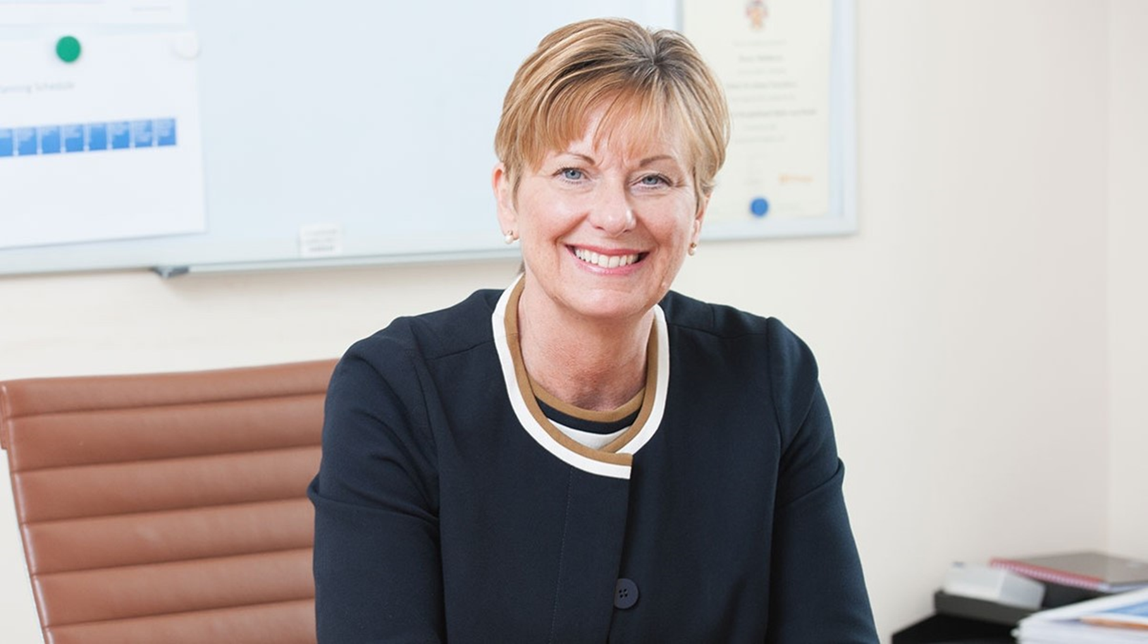
A personal perspective
Notes:
I am committed to this
– this is why –
personal insights and perspective from own experiences with support workers

Slide 8

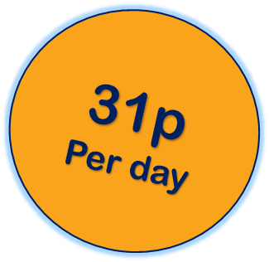
2,000 Associate members www.csp.org.uk/benefits
Protection and support at work
Professional support and advice
Access to professional tools and development
Professional journal and monthly magazine
Funding opportunities
Leadership opportunities
Networking and influencing opportunities
Money saving deals
Notes:
Insurance
Legal services
Workplace representation
iCSP – access to your own Associate’s network, connecting you to other support workers where you can discuss the things that matter to you
ePortfolio
Learning Hub
physio-specific library and information services .
The mentoring scheme
Charitable Trust Education Awards
Frontline magazine
Physiotherapy News
Physiotherapy
Access to Regional and professional networks
Join one of the CSP's committees or become a steward or safety rep
The Enquiries Team
Professional Advice Team
The Members’ Benevolent Fund
Exclusive deals and discounts via CSP Plus

Slide 9


QUESTION TIME
www.csp.org.uk/join-csp/join-associate-member
@thecsp
@KMiddletonCSP
@theCSPstudents
Chartered Society of Physiotherapy
Notes:
Take home message we are stronger, more credible and more able to do this with support workers in our membership. If you are a member – be active with us. If you are a non-member join us in doing this - please consider joining our/your community – You are the CSP
Questions?

