Slide 2


Gemma Pugh & Jane Clarke
Notes:
Good afternoon conference
Our role as your Network leads is to ensure that we raise the profile and issues which are local to southwest members
We would like to give you an overview of the Annual Representative Conference, the aims, the process and show you an example.
We are then going to ask you to work in groups to discuss, listen and debate issues/ & themes in your area and finally choose a few to develop for 2019

Slide 3
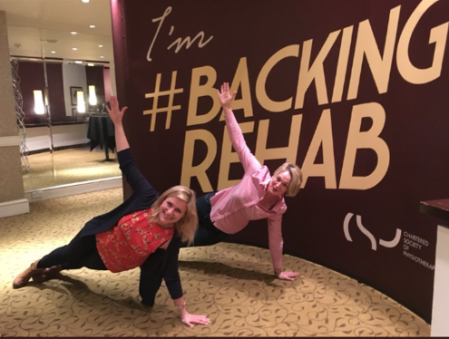
What is ARC?
2 day conference, fully funded by the CSP
Your opportunity to have your say
A chance to highlight current issues
An enabler to create interest groups or showcase
your teams work by holding a fringe meeting
Notes:
ARC is an advisory body to the CSP’s democratically elected council
(NB, ARC resolutions are therefore not automatically mandatory)
1) to bring together a wide representation from across the membership to discuss, debate and vote on motions submitted by members
2) To influence the CSP’s policy and strategic direction
3) create and write a motion on behalf of your workplace, or members group
4)

Slide 4
Who attends?
Representatives from the following networks
Stewards
Health & safety reps
Regional network and country boards
Professional networks
Students
Associates
Diversity networks: Disabled members, BME, and LGBT+
Retirement network
Notes:
Each network is allocated a number of seats, members are generally asked to apply to represent their network and priority is given to those who have not attended before.
Council Members are welcome to attend as observers.

Slide 5
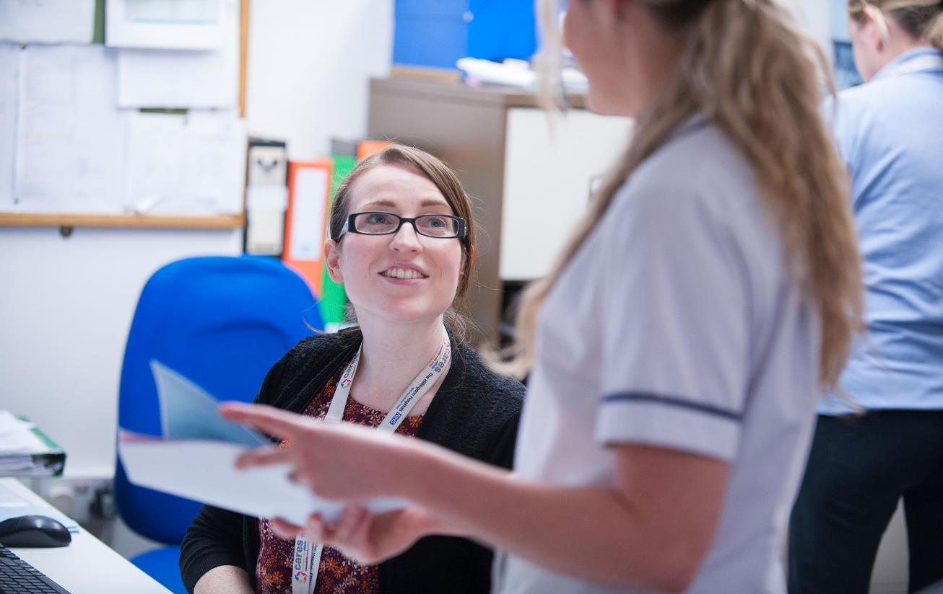
What is a motion?
Notes:
A motion is a formal proposal which has to follow guidelines determined by the CSP , it should be no longer than 200 words and must be submitted by a network by a specified deadline.
The motion will then be checked by a committee which will look to see if it is appropriate and has not been submitted and debated in the last 2 years and that there are no duplicate submissions. If the motion is successful, the candidate & network will be advised.
The written information is then circulated in advance of the conference for members to consider & discuss.

Slide 6
Motion
Original, 200 words long and cover current issues
In a subject area that relates to the CSP strategic objectives
Relevant and good to debate
Motion start | This conference believes/ requests /demands
Action by whom? | The CSP
What action? | should work with other trade unions to strongly campaign for………. the retirement age of clinical physiotherapists to be 55 years old
When? | Immediately
What reason? | To protect the health and well being of our profession
Notes:
Proposers who are successful are given guidelines to write a timed speech which explains the motion in full, and must find a member from another network to present a second speech in support of the motion.
The motion should deal only with one topic, be within the CSPs gift to influence and cost implications should have been considered.

Slide 7
Example
Notes:
We have created an example to show you what it is like to attend. There are further rules regarding time, electronic voting and what happens when consensus cannot be achieved which we cannot duplicate but hopefully this will be enough to make you want to attend and experience it for yourself!
Jane 1st Motion, Gemma 2nd motion, when the speeches are complete, the floor is opened and members can come forward from thw audience to speak for or against the motion on stage. Today we have asked 2 members to prepare to give you a flavour.
Jane then has the right to reply.
All these responses have a time limit.
If a motion is accepted, it is then called a Resolution and becomes policy of the conference.

Slide 8
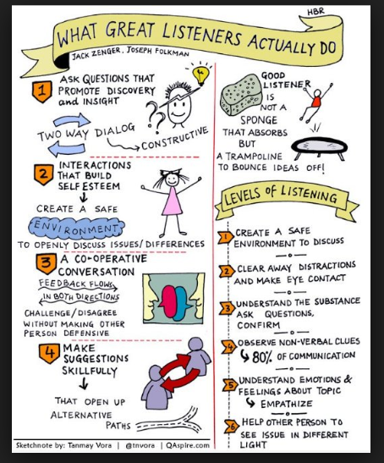
Listening event: 15 minutes
Stand up, network and break out into
groups of 10
Discuss the issues you brought with you today
Agree on one issue and expand using
the flip chart paper

Slide 9

Butterflies and Bees 15 minutes
One member to remain with your flip chart poster
Everyone else to move around and read & question other group ideas
Please think about which issue you would like to be developed
#LoveActivity
Notes:
Ask members to add a tick to the poster they like the most, and add their names if they would like to develop.

Slide 10

Conclusion
Did you have a healthy debate in your groups?
Did you see it from another view point?
Did you consider the cost implications of your motion?
Is the CSP the right organisation to campaign for this change?
Notes:
Experience from ARC 2019
When we listened to the speakers and heard the passion and examples used for the motion, there were occasions where we changed our vote
We felt worried at the amount of motions which were voted in, the CSP only has one pot of money and we need to focus on what the members priorities are.

Slide 11

What happens next ?
We (SWERN) would very much like to submit 3 motions to the committee on behalf of southwest members
If you would like to develop a motion and/or present at ARC please come and chat to us.
Deadline for submitting ARC Motions
12 noon on Monday 4 March 2019
Notes:
Need our Internal deadline!!

Slide 12
The 2019 Annual Representative Conference will be held in Manchester on Monday 3 and Tuesday 4 June 2019 #CSPARC19

