Slide 2

Catherine Chappell
Campaigns and Regional Engagement Officer
@CChappellCSP
chappellc@csp.org.uk
020 7314 7863
Notes:
Campaign playlist -
https://www.youtube.com/playlist?list=PLLaYpsruKX9KaB20QJfHhCtKiKdIfrGCW&disable_polymer=true

Slide 3
Notes:
A member, we want to help you tackle physical inactivity.
In May we launched an evidence based campaign that gets people more active through physios’ advice and expertise.
Our campaign aims to improve this by focusing on people who find it difficult to start and maintain exercise.
We want members to make recommendations with patients, start a conversation and understand the power of starting the conversation.
There are CSP materials and resources available for you to tailor locally and use as a basis for conversations with patients – more about these later.
We know that our ultimate goal is to speak with the public and with patients, but it’s about leaving them with a lasting feeling about the usefulness of the trusted physio and/ or physio advice/ expertise.
We want the public audience to:
Feel that we show empathy
Believe physios are best placed to help advise them about physical activity in the first instance,
Understand that a physio can help them overcome the barriers to physical activity so that they can do more of what they love doing and convert that into meaningful exercise.
seek out information from our website www.csp.org.uk/activity
Feel comfortable to initiate / participate in a conversation with physio staff
Ultimately we want to raise the profile of physiotherapy and promote the profession
Love activity, Hate exercise? recognises that people often have a love/hate relationship with physical activity and exercise but with our newly produced materials, tips and ideas, we hope to provide physios with the resources to help patients overcome these barriers. The question mark is super important...

Slide 4
Adults should undertake physical activity to improve muscle strength on at least ? days a week.
Only ? per cent of UK adults do the recommended minimum of ? minutes of moderate to vigorous exercise each week.

Slide 5
The power of a conversation
Notes:
Power of a conversation: Healthcare professionals version:
https://vimeo.com/277280317
Who can you share this with? Who needs to know more about the power of physio in the Y&H?

Slide 6
Get involved…
Notes:
For physio staff.
https://www.youtube.com/watch?v=HY6o_1x71IQ&t=5s

Slide 7


Slide 8
Real life examples
Notes:
Inspiring videos
Leanne https://www.youtube.com/watch?v=WYlxYfr98Os
Emma https://www.youtube.com/watch?v=tMenY6DG6OI

Slide 9
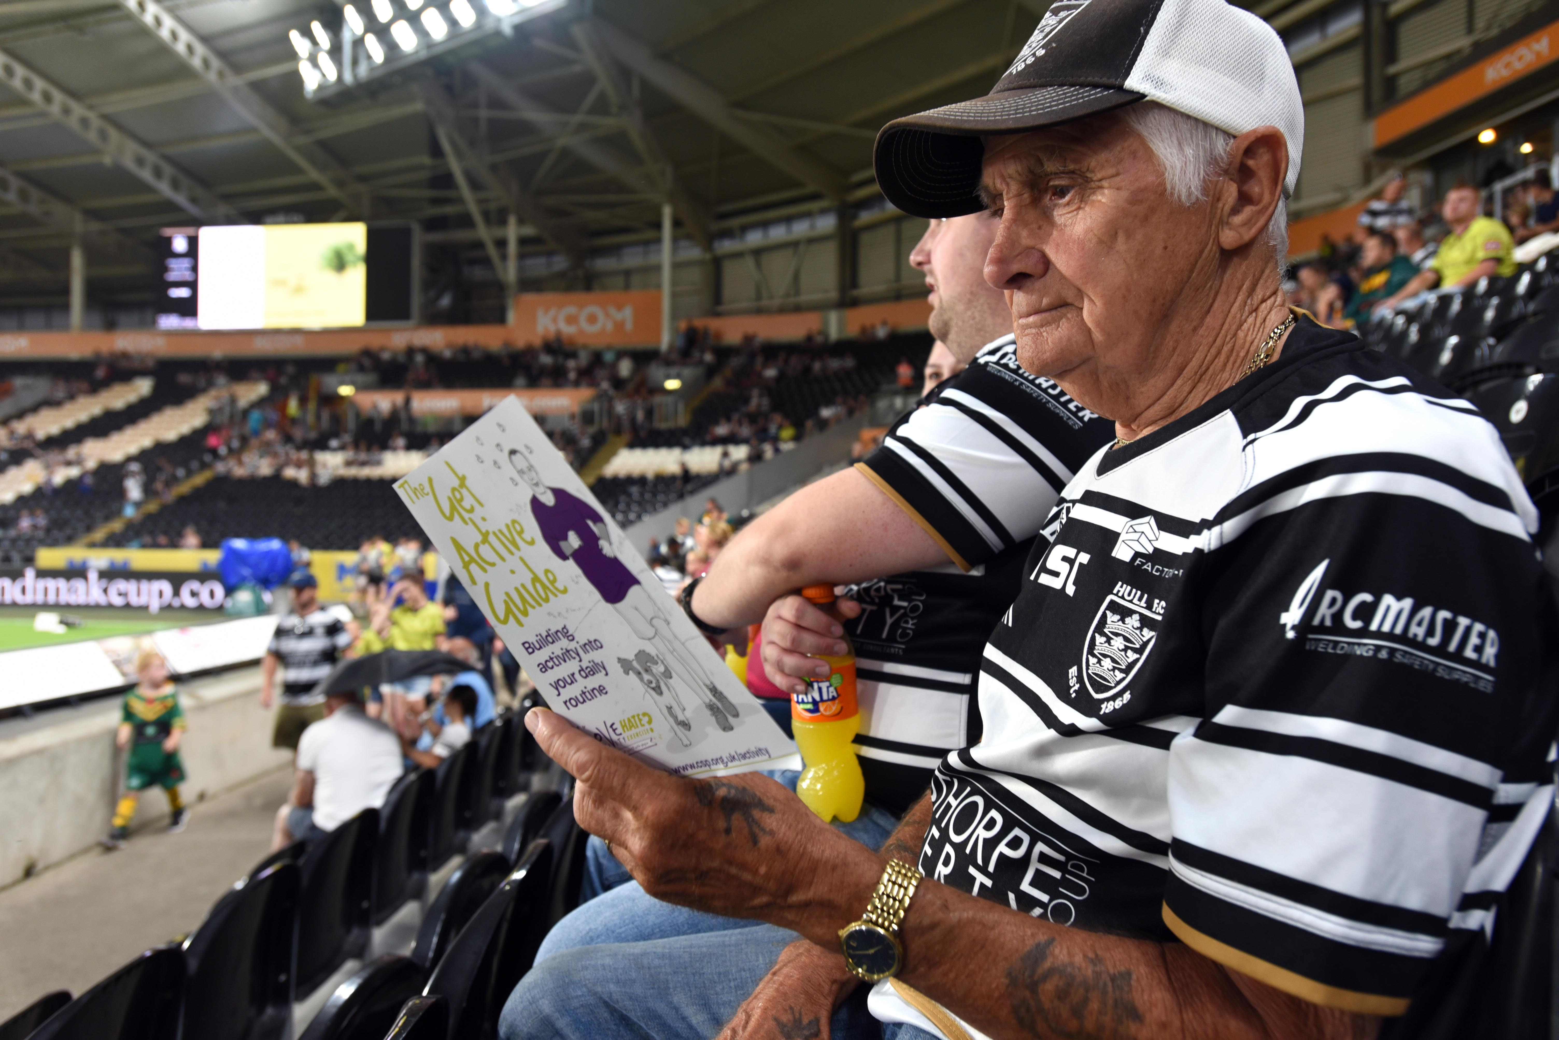
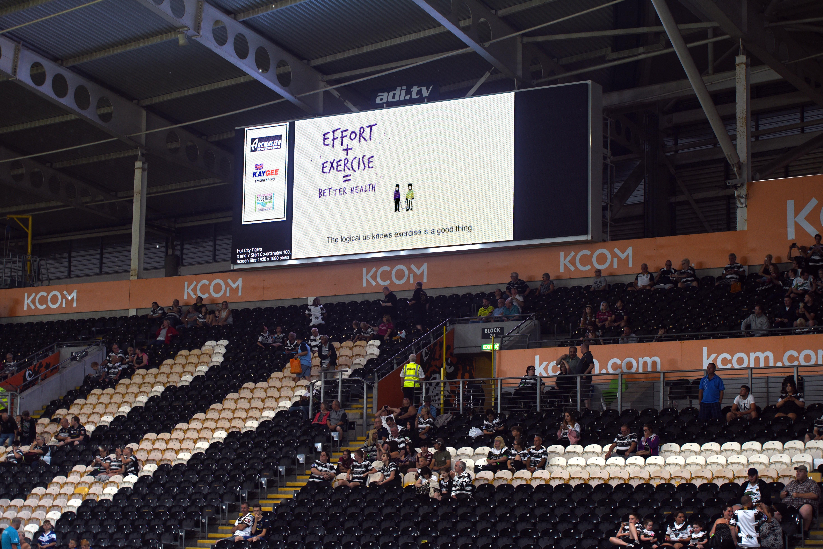
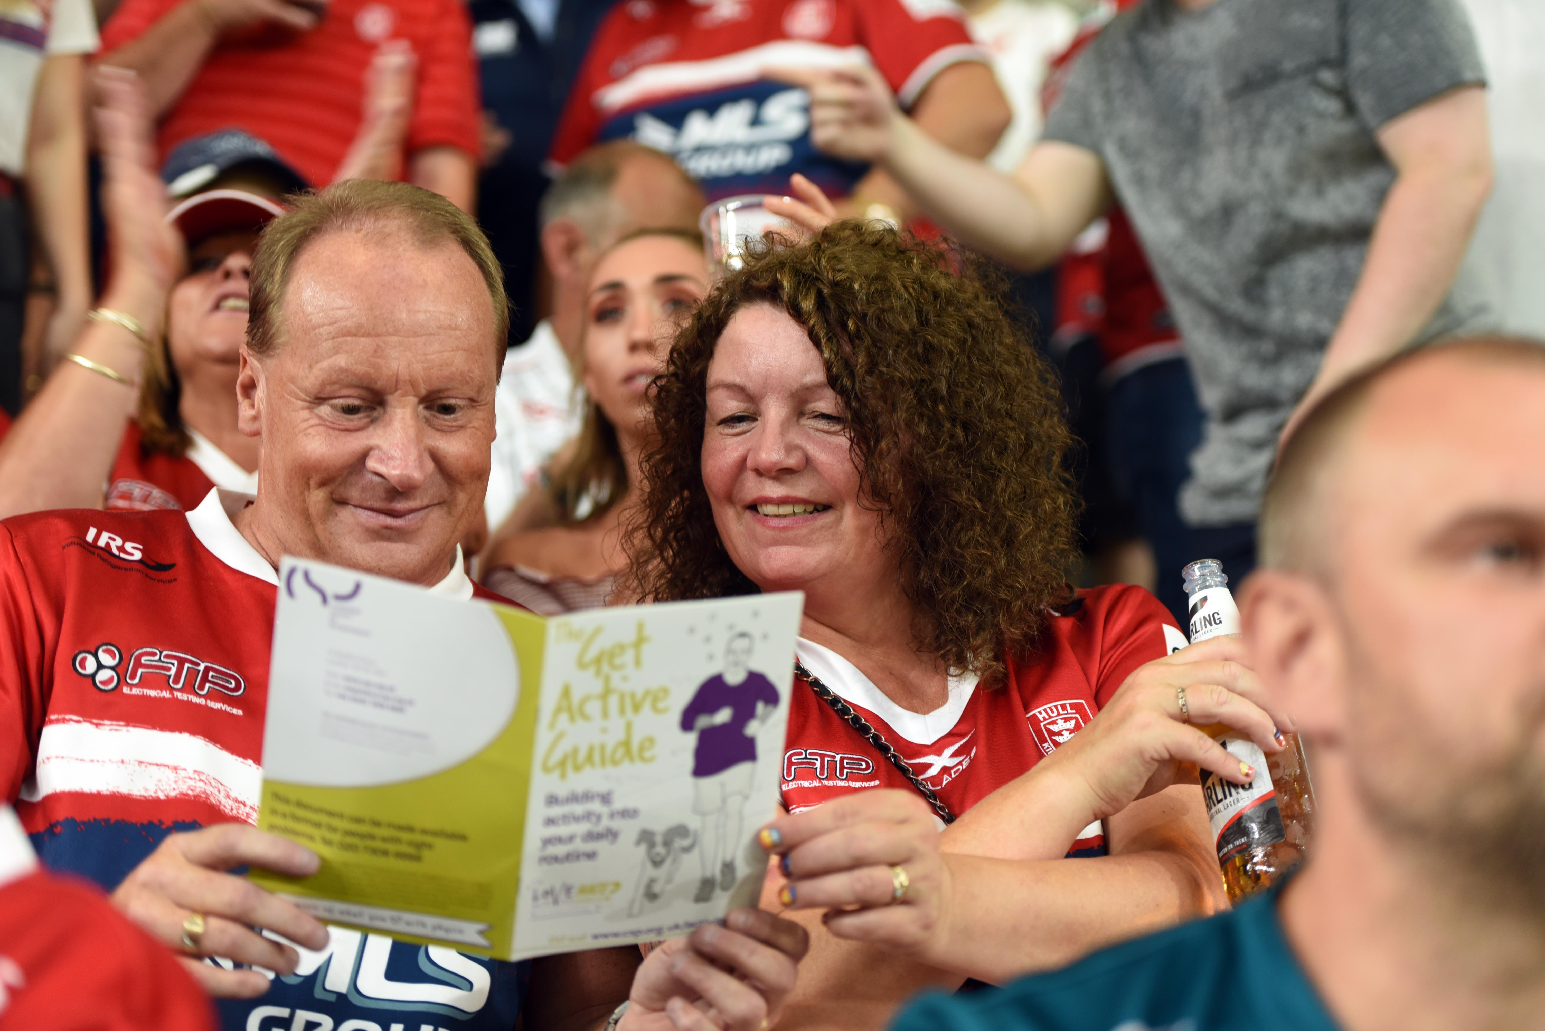

Slide 10
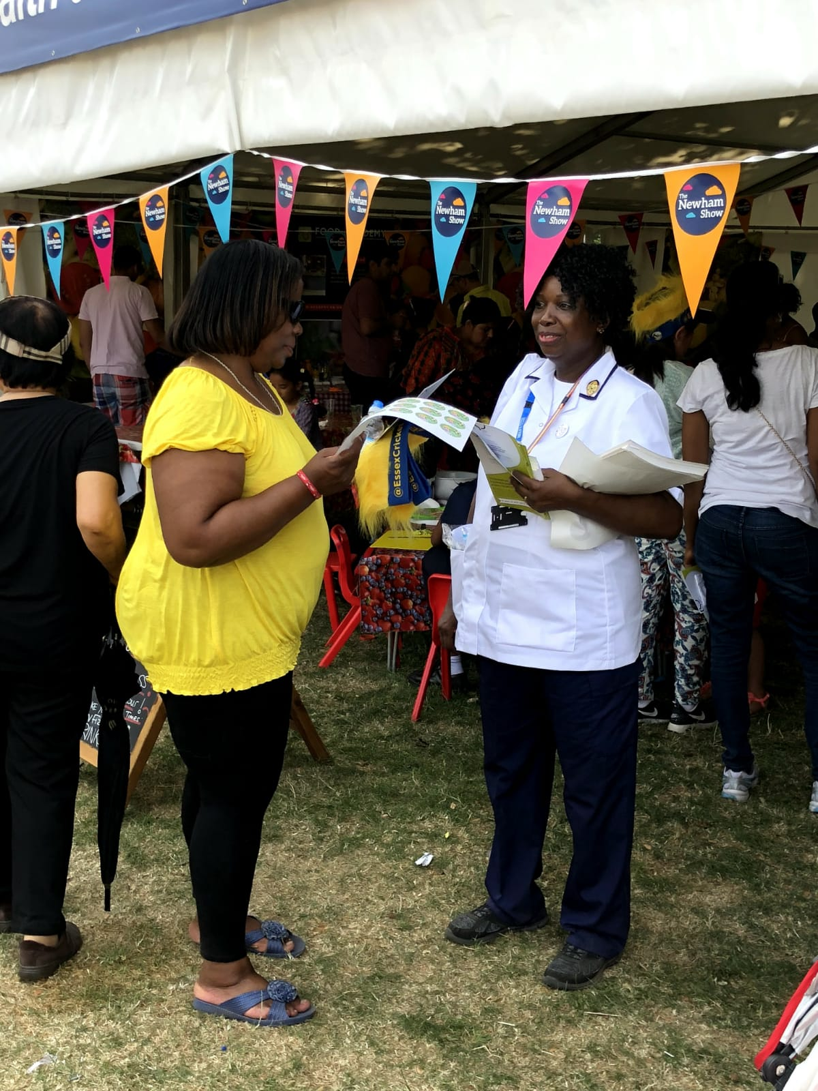
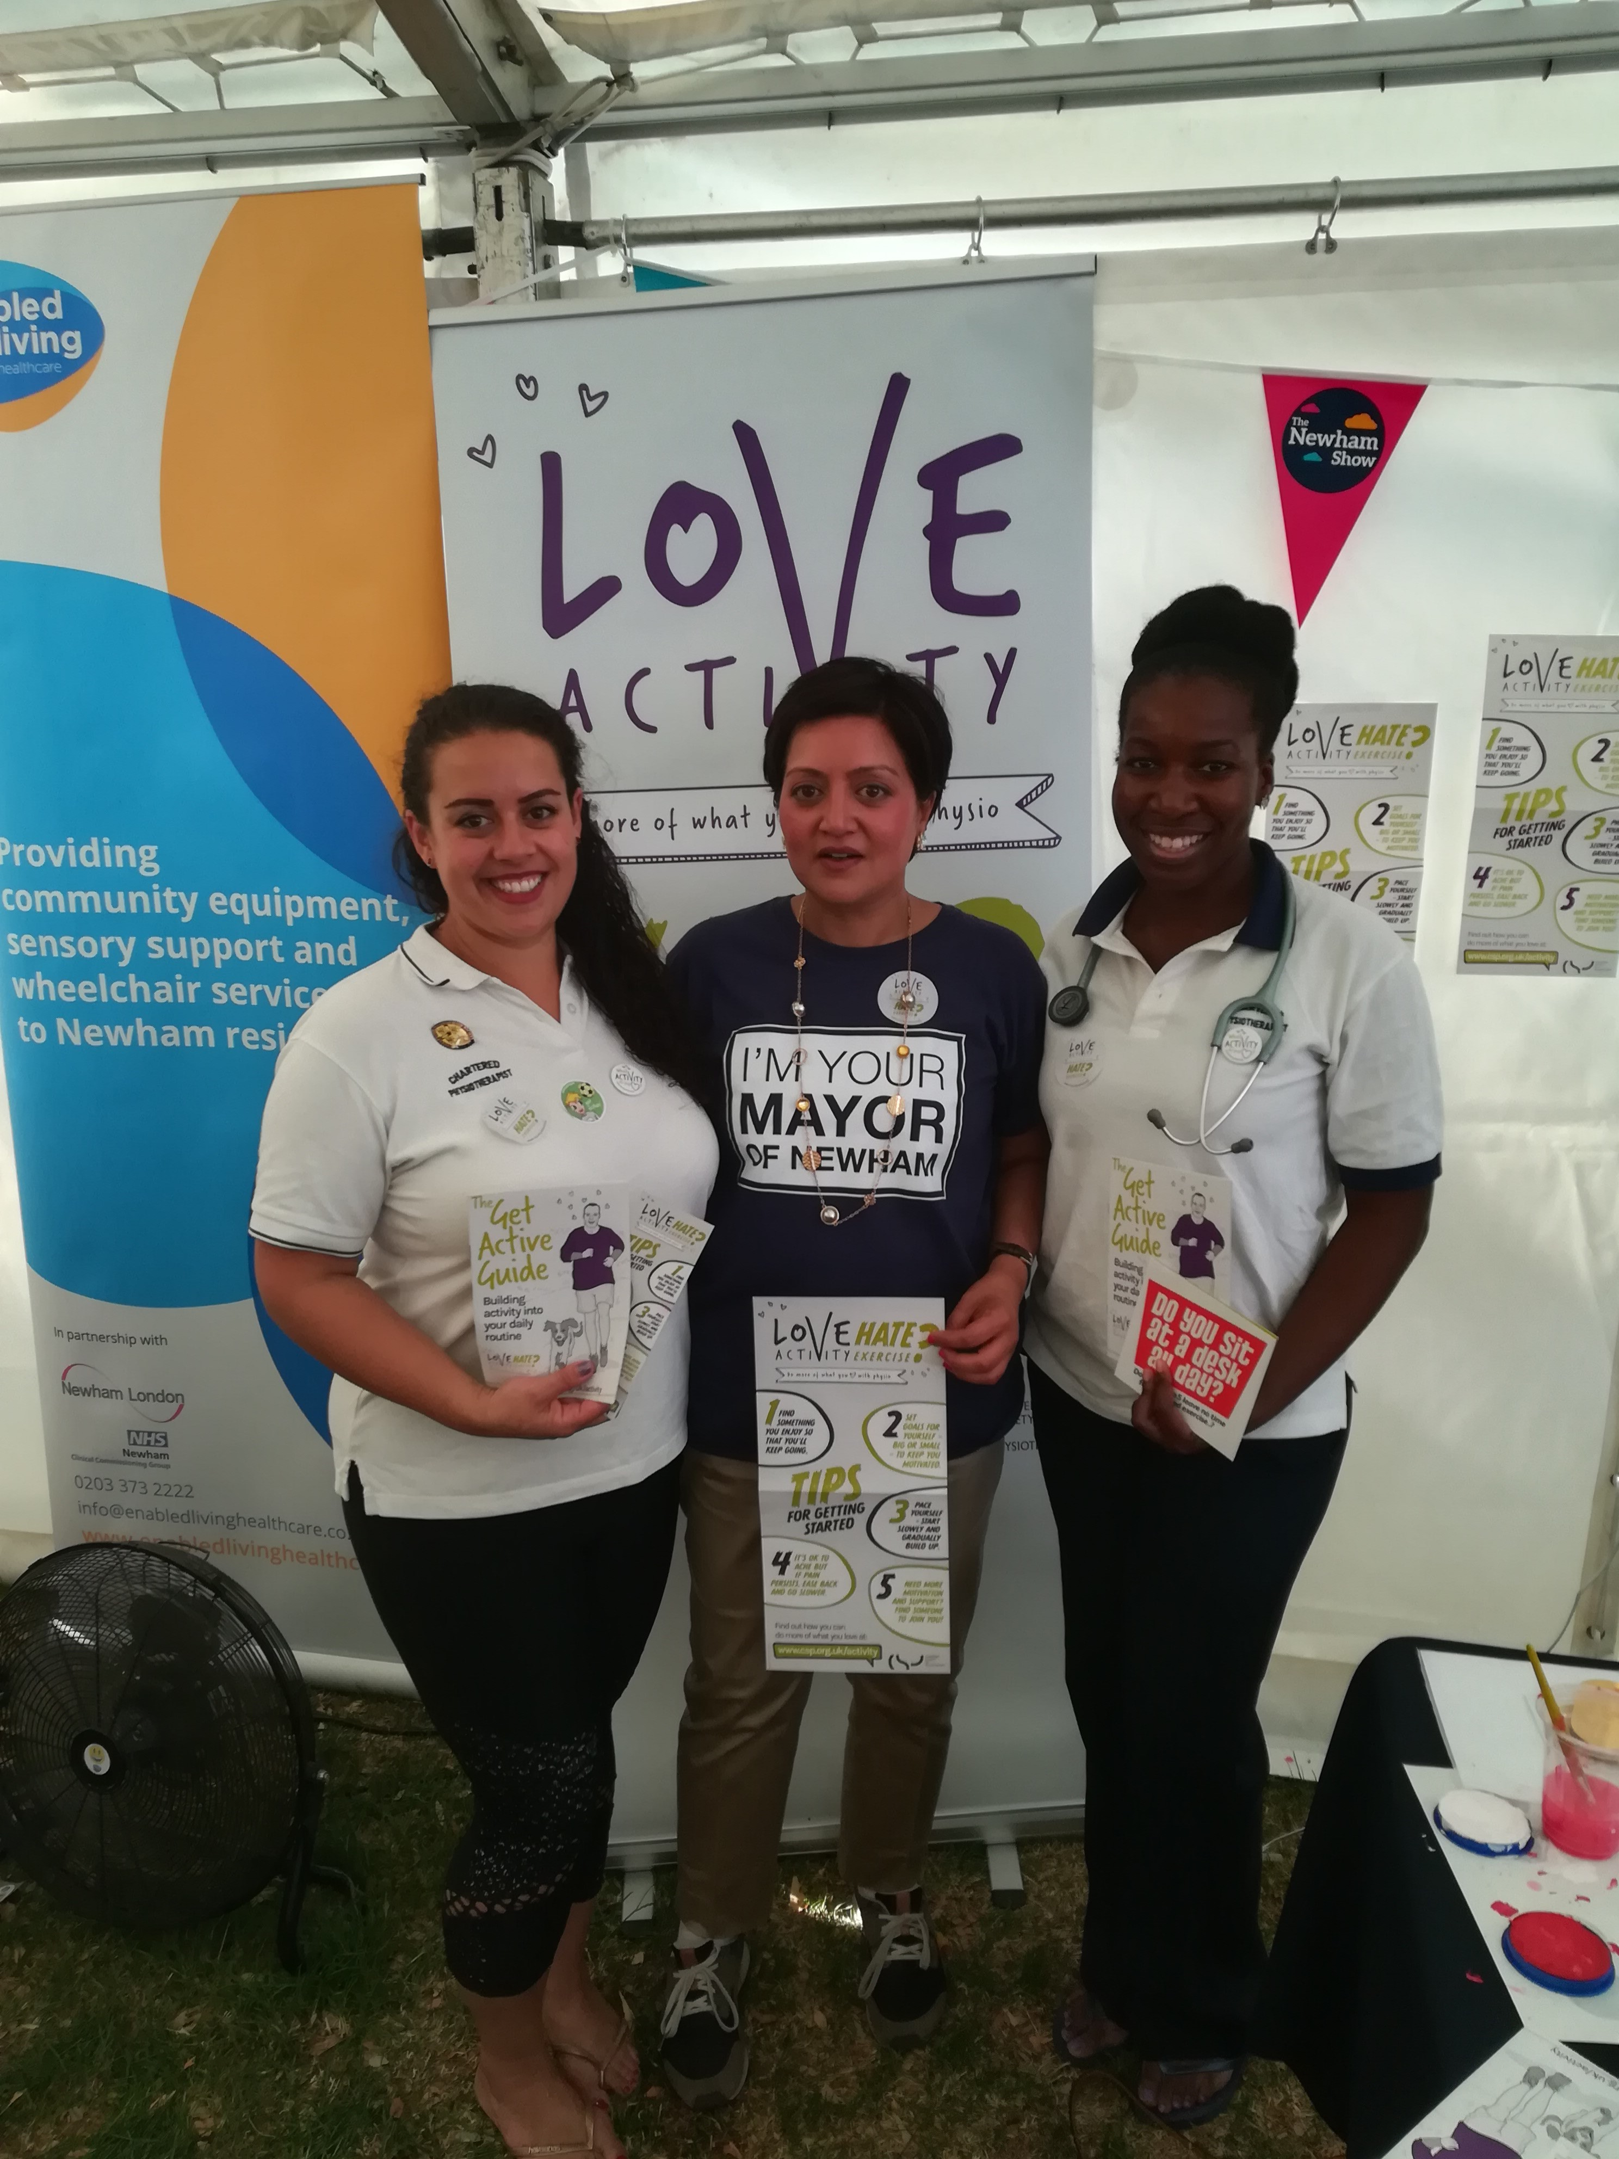
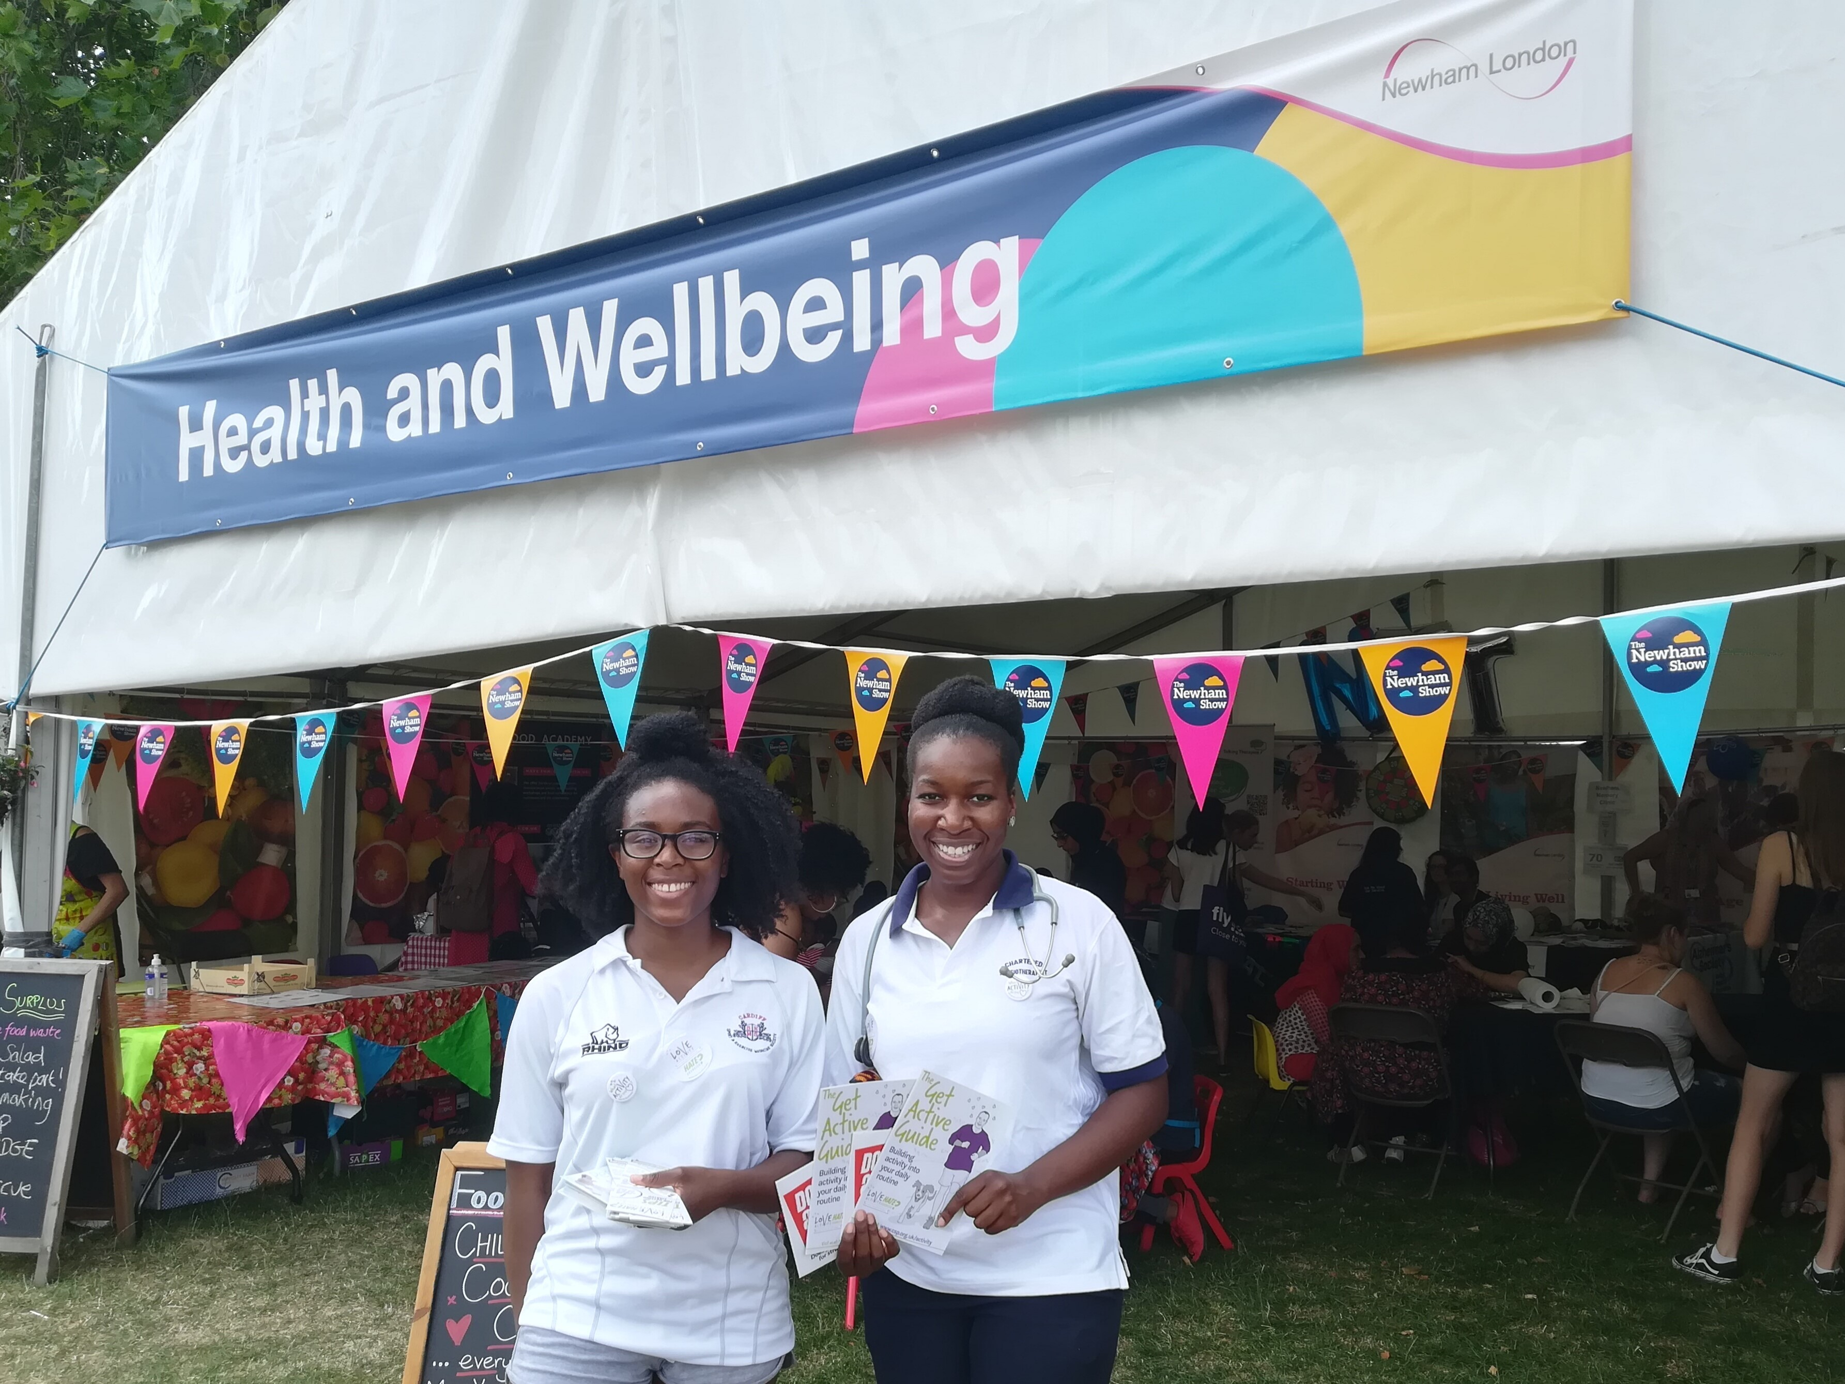

Slide 11

Notes:
INFLUENCING
Power of a conversation: Healthcare professionals version:
https://vimeo.com/277280317
WWW.CSP.ORG.UK/ACTIVITY - PUBLIC FACING PAGE
Get inspired Love activity page –
https://www.csp.org.uk/public-patient/keeping-active-and-healthy/love-activity-hate-exercise-campaign/get-inspired

Slide 12
Older People’s Day 2018
Monday 1st October
www.csp.org.uk/OPD
www.csp.org.uk/nevertoolate
Notes:
OPD
We’re celebrating Older People’s Day 2018 with the Love activity, Hate exercise? campaign
More than 2,000 CSP members have signed up to Love activity, Hate exercise? since registration opened in May. We want to harness this energy to make this year’s Older People’s Day campaign (Monday 1 October) the biggest and best yet so that more people are inspired to do physical activity in a safe and meaningful way.
OPD – This year OPD is linked to the Love Activity campaign and will be focusing on helping people to stay as active as possible as they age. OPD will continue with the empathy approach (we took with LAHE) whilst also conveying that in order to make the most of the later years and reduce the risk of falls, illness and injury, people need to make time to do the right sort of exercise to build strong muscles and bones.
The CSP web page went live yesterday and can be found here: www.csp.org.uk/OPD
A series of new resources will be added to the OPD member page, when they are ready. These include:
NEW (from end of September) Never Too Late animation – this will encourage patients to engage in the right type of exercise and activity for a healthy future. We’ll be encouraging members to share the animation with patients, contacts and colleagues.
NEW Never Too Late leaflet – highlights advice for improving strength and balance
Love Activity, Hate Exercise? tailored presentations which members can use to run an influencing event aimed at GPs or patients. The presentations contain all the information needed including slides and explanatory notes. Amended in collaboration with Agile.
Public page will be https://www.csp.org.uk/nevertoolate - same title as the new animation. This will also feature the PDF leaflet and a OPD version of the Active Stories.
In addition CSP members who opted to received OPD packs will receive them by 21st September and they will include:
Badges
Reminder cards
Never Too Late leaflet and poster
Stickers

Slide 13
Love Activity challenge!
Notes:
#LoveActivity – using social media to inspire patients and the public to do more of what they love with physio
You have 20 minutes .
Your task - use a smart phone to film a 30 second clip demonstrating a key message about #LoveActivity
Tips:
Plan your message and how you can deliver it effectively
Spend more time planning and execute it fast!
Use one simple shot – with no editing required
Use the Boomerang app if you have it on your smart phone
Once your film is finished put it on Twitter tagging @CSPYorksHumber and using the hashtags #loveactivity and #physiofit4thefuture in your message
If you’re happier taking photos then take photos, if you’re happier collating your ideas in words and sharing a photo of that – then do that!

Slide 15
Catherine Chappell
Campaigns and Regional Engagement Officer
@CChappellCSP
chappellc@csp.org.uk
020 7314 7863

